Slide 1
Applying AI with Python
Alex Conway
alex@numberboost.com

Slide 3
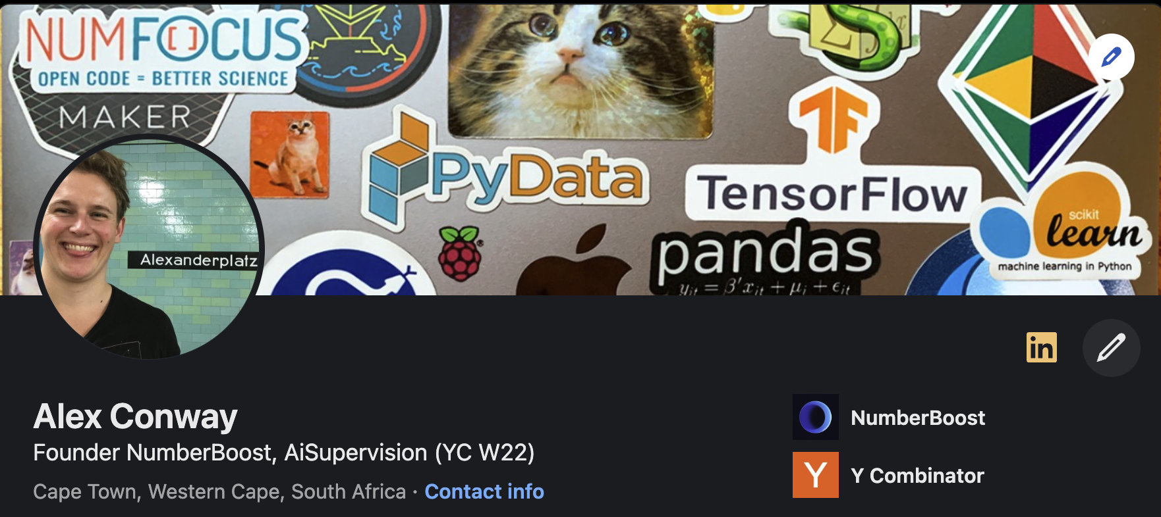
x.com/alxcnwy linkedin.com/in/alxcnwy/

Slide 4
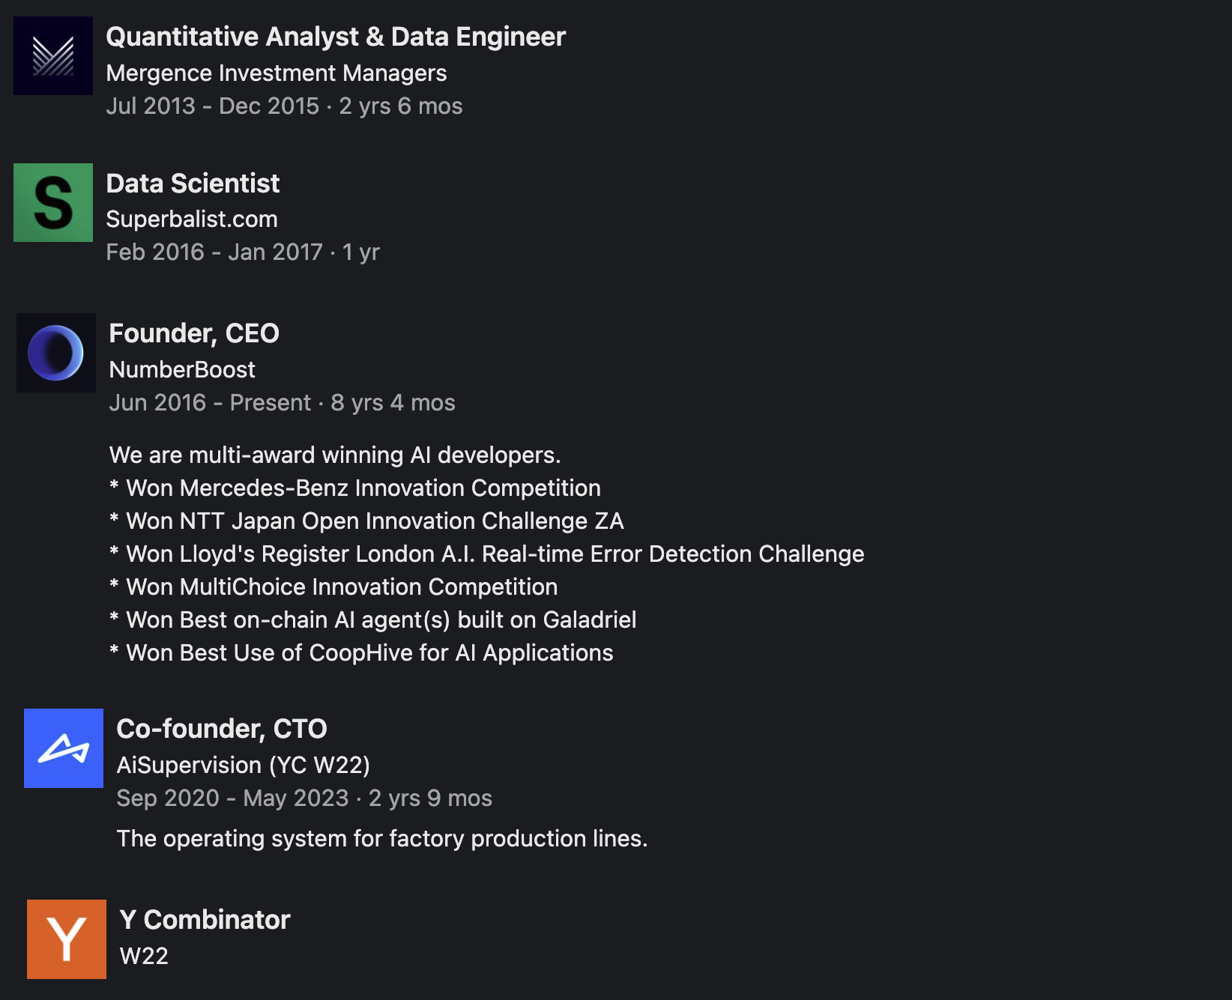

Slide 9
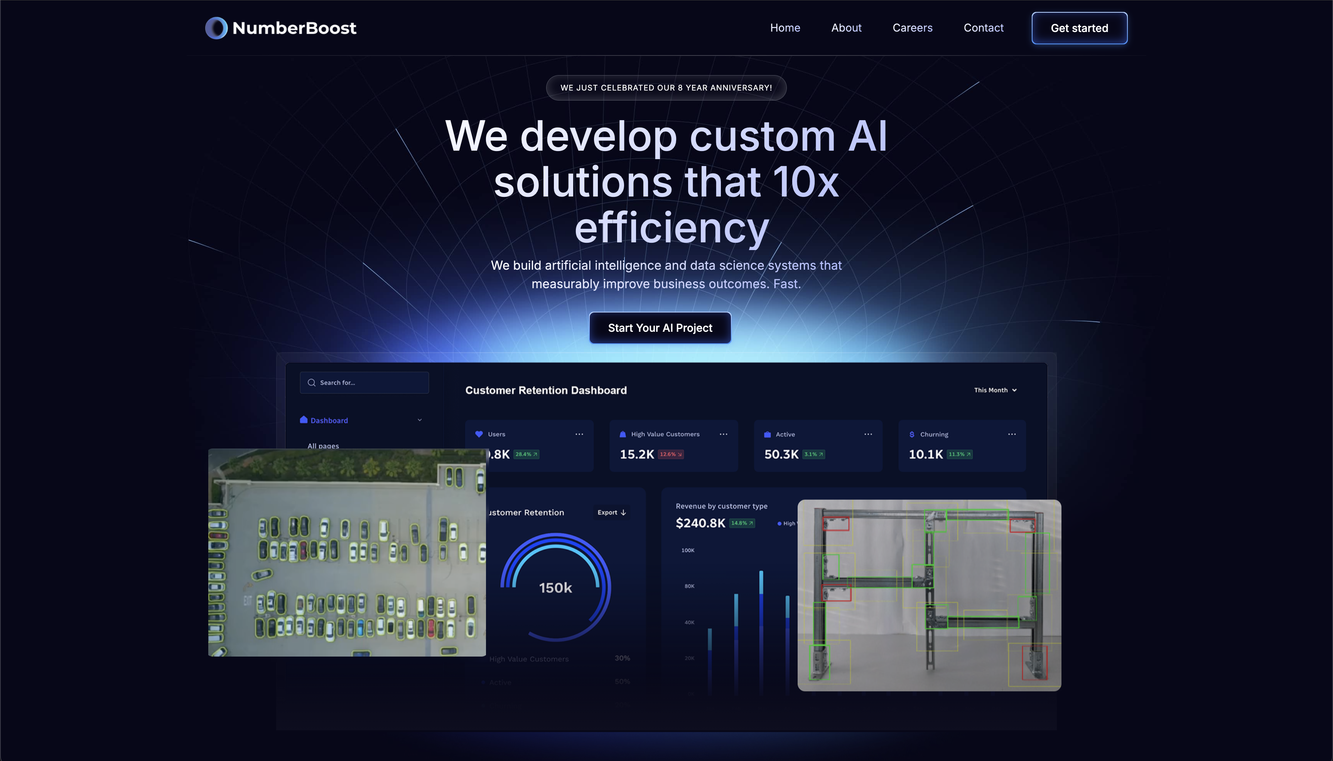

Slide 10
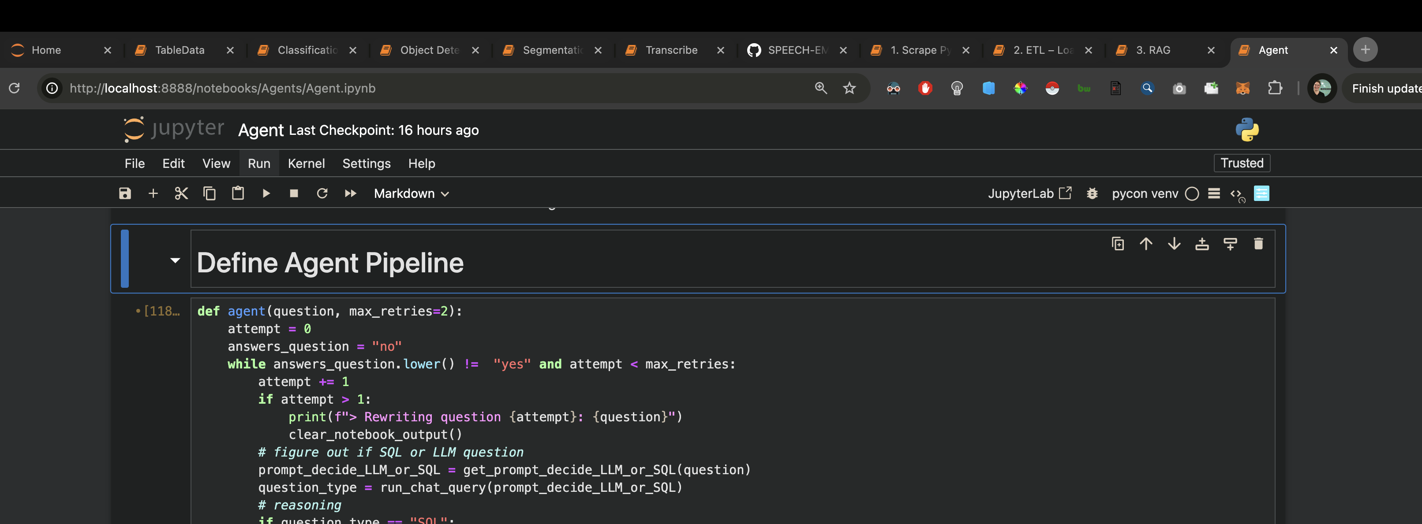
8 notebooks 150 slides let’s gooooo

Slide 11
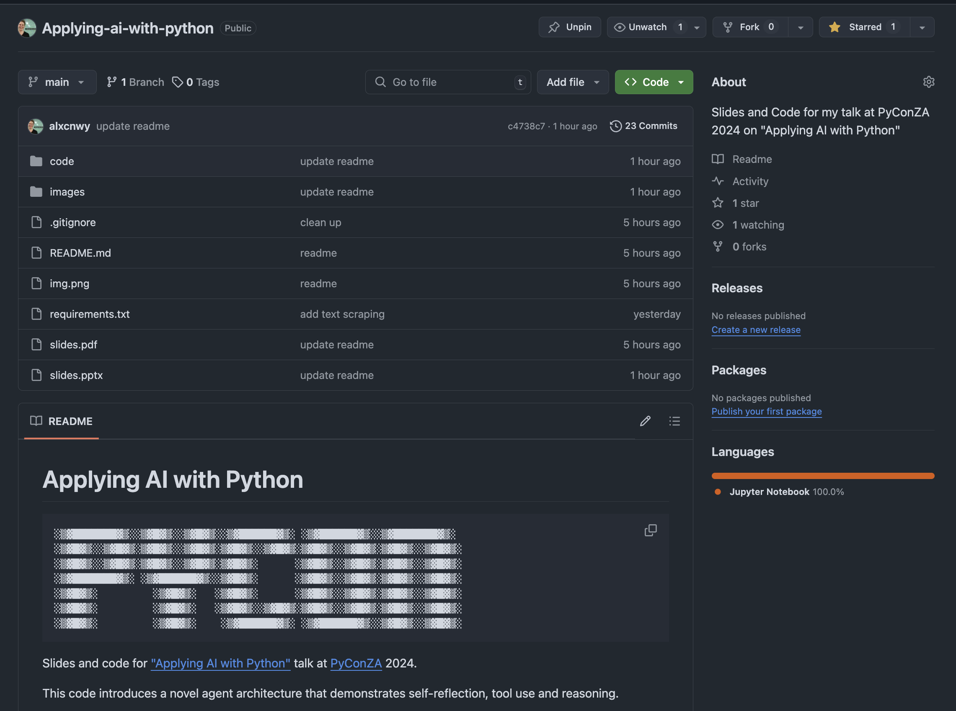

Slide 12

github.com/alxcnwy/applying-ai-with-python

Slide 13

What is Artificial Intelligence (AI)?
3

Slide 14
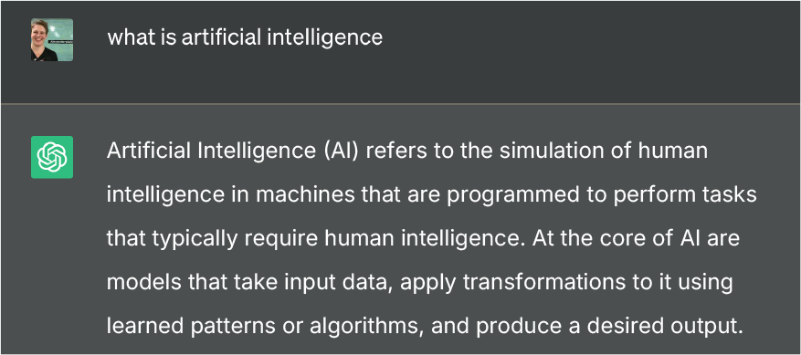

Slide 16

def ai_model(input):
#
# algorithms f(input) = output
#
return output

Slide 17
def ai_model(input):
#
# algorithms f(input) = output
#
return output

Slide 18
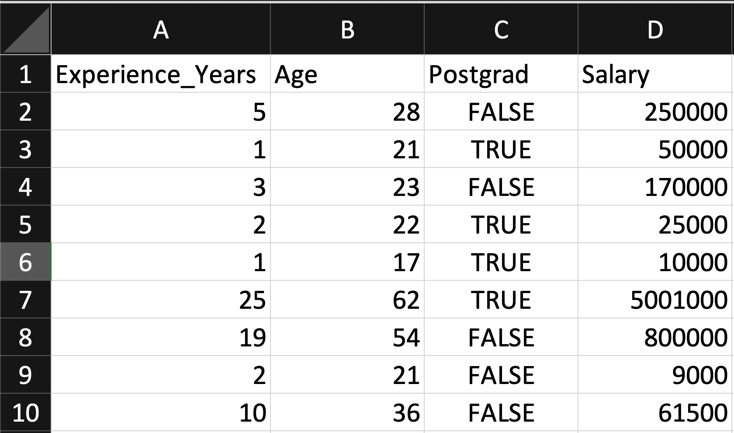
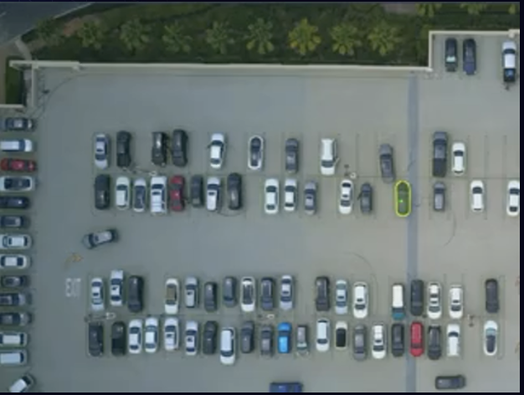
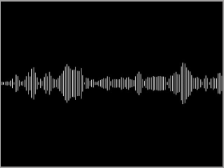
Input
Table
Image / Video
Artificial Intelligence (AI) is transforming industries and our lives by enabling computers to solve increasingly complex tasks, and Python stands at the forefront of this revolution. In this talk, we will explore how Python's rich ecosystem of AI libraries and frameworks can be harnessed to
Text
Audio

Slide 19
def ai_model(input):
#
# algorithms f(input) = output
#
return output
5
Notes:
5 Min

Slide 20
Algorithm Terminology
(Supervised) Regression (predict a number)
(Supervised) Classification (predict a category / label)
Unsupervised (find patterns within a dataset without labels)
Generative (create new data / content)
7

Slide 21
Types of AI Algorithms
Regression (Linear / Polynomial / Logistic, etc.)
Decision Trees (Random Forests, GBMs, etc.)
Clustering (K-Means, Spectral, DBSCAN, etc.)
Neural Networks (Convolutional, Recurrent, Transformer, etc.)
etc…

Slide 22
Don’t Panic!
No Math Here
can you copy & paste?
3

Slide 23
def ai_model(input):
#
#
#
return output
Examples incoming (brace yo’self)

Slide 24
def ai_model(input):
#
# algorithms f(input) = output
#
return output

Slide 25
Output
Table
Image / Video
Artificial Intelligence (AI) is transforming industries and our lives by enabling computers to solve increasingly complex tasks, and Python stands at the forefront of this revolution. In this talk, we will explore how Python's rich ecosystem of AI libraries and frameworks can be harnessed to
Text
Audio

Slide 26
Output
Table
Image / Video
Artificial Intelligence (AI) is transforming industries and our lives by enabling computers to solve increasingly complex tasks, and Python stands at the forefront of this revolution. In this talk, we will explore how Python's rich ecosystem of AI libraries and frameworks can be harnessed to
Text
Audio

Slide 27
Output
Table
Image / Video
Artificial Intelligence (AI) is transforming industries and our lives by enabling computers to solve increasingly complex tasks, and Python stands at the forefront of this revolution. In this talk, we will explore how Python's rich ecosystem of AI libraries and frameworks can be harnessed to
Text
Audio

Slide 28
Output
Table
Image / Video
Artificial Intelligence (AI) is transforming industries and our lives by enabling computers to solve increasingly complex tasks, and Python stands at the forefront of this revolution. In this talk, we will explore how Python's rich ecosystem of AI libraries and frameworks can be harnessed to
Text
Audio

Slide 29
Output
Table
Image / Video
Artificial Intelligence (AI) is transforming industries and our lives by enabling computers to solve increasingly complex tasks, and Python stands at the forefront of this revolution. In this talk, we will explore how Python's rich ecosystem of AI libraries and frameworks can be harnessed to
Text
Audio

Slide 30
Output
Table
Image / Video
Artificial Intelligence (AI) is transforming industries and our lives by enabling computers to solve increasingly complex tasks, and Python stands at the forefront of this revolution. In this talk, we will explore how Python's rich ecosystem of AI libraries and frameworks can be harnessed to
Text
Audio

Slide 31
Output
Table
Image / Video
Artificial Intelligence (AI) is transforming industries and our lives by enabling computers to solve increasingly complex tasks, and Python stands at the forefront of this revolution. In this talk, we will explore how Python's rich ecosystem of AI libraries and frameworks can be harnessed to
Text
Audio

Slide 32
Output
Table
Image / Video
Artificial Intelligence (AI) is transforming industries and our lives by enabling computers to solve increasingly complex tasks, and Python stands at the forefront of this revolution. In this talk, we will explore how Python's rich ecosystem of AI libraries and frameworks can be harnessed to
Text
Audio

Slide 33
Output
Table
Image / Video
Artificial Intelligence (AI) is transforming industries and our lives by enabling computers to solve increasingly complex tasks, and Python stands at the forefront of this revolution. In this talk, we will explore how Python's rich ecosystem of AI libraries and frameworks can be harnessed to
Text
Audio

Slide 34
Output
Table
Image / Video
Artificial Intelligence (AI) is transforming industries and our lives by enabling computers to solve increasingly complex tasks, and Python stands at the forefront of this revolution. In this talk, we will explore how Python's rich ecosystem of AI libraries and frameworks can be harnessed to
Text
Audio

Slide 35




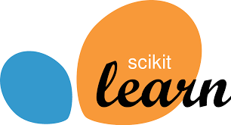



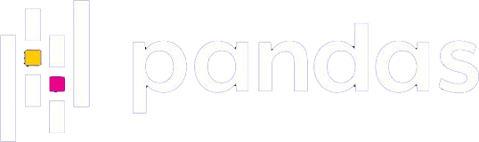
Why Python for AI?
Easy to use (ML researchers often != software engineers)
Massive community (easy to find answers to questions)
Extensive libraries and frameworks (don’t need to invent to use)
10
Notes:
10 min

Slide 36
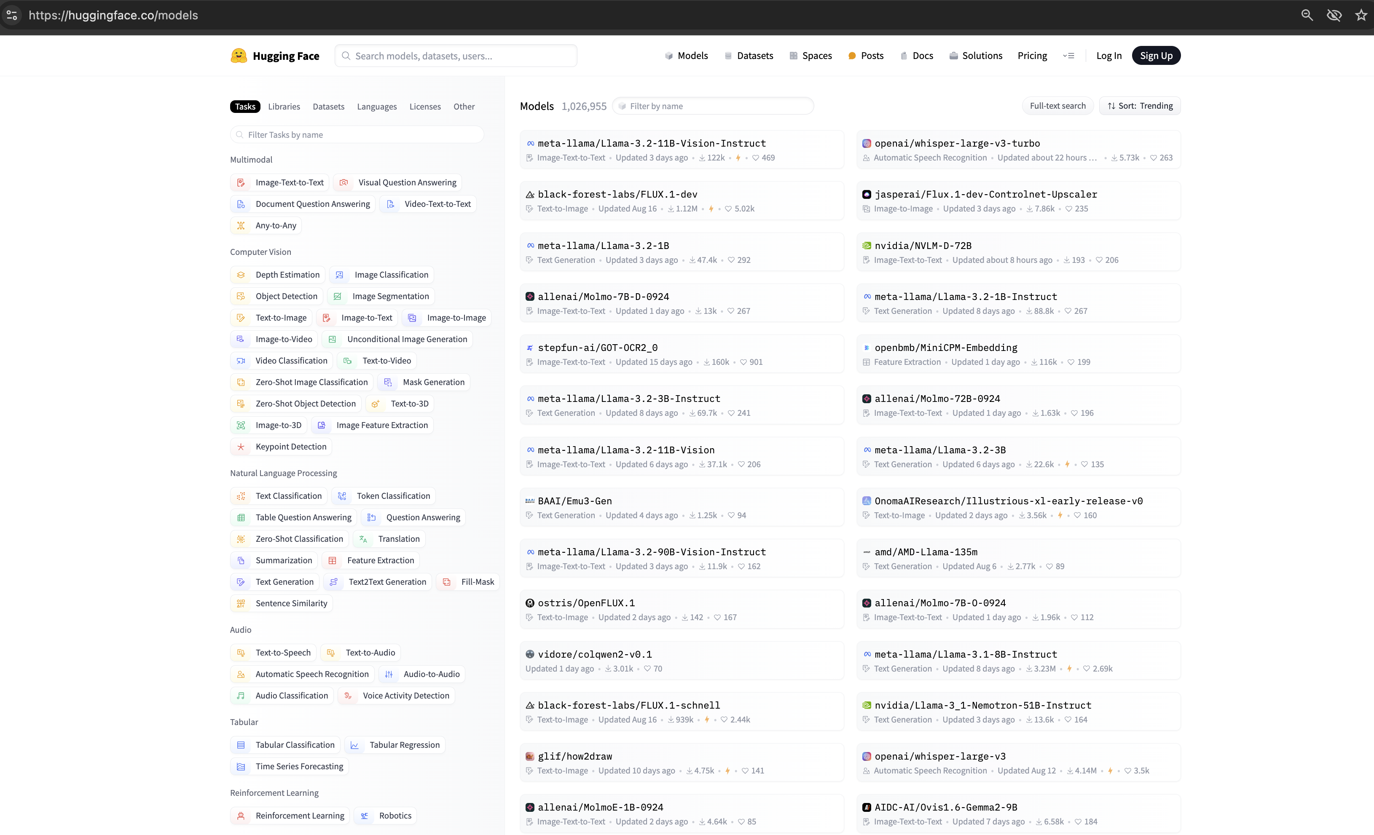

Slide 37
Image/
Video
Text
Audio
Table

Slide 38
Table Data
12

Slide 39
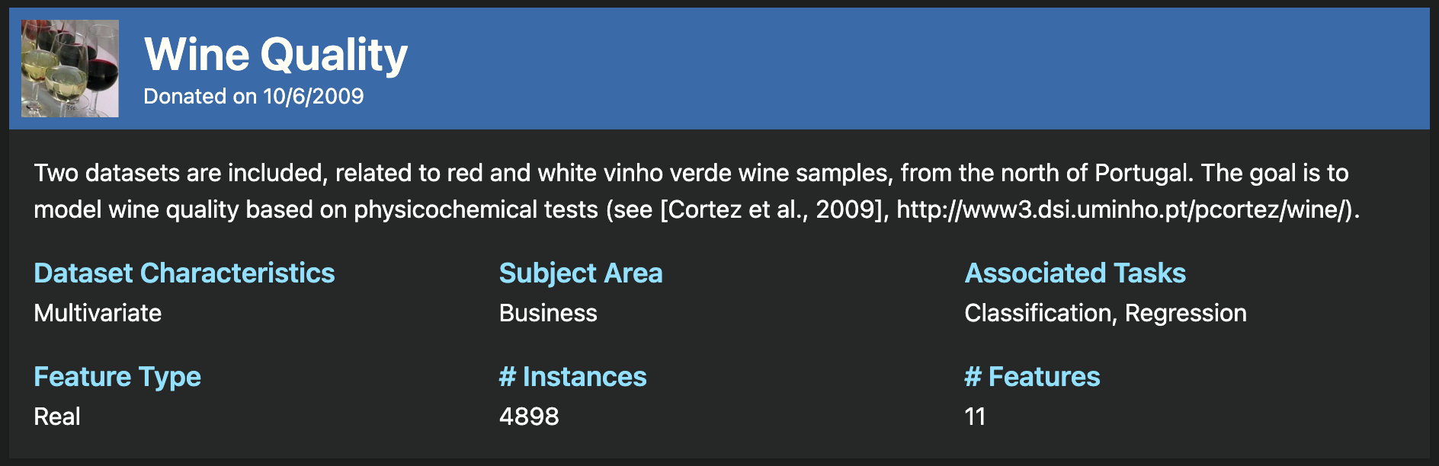
https://archive.ics.uci.edu/dataset/186/wine+quality

Slide 40
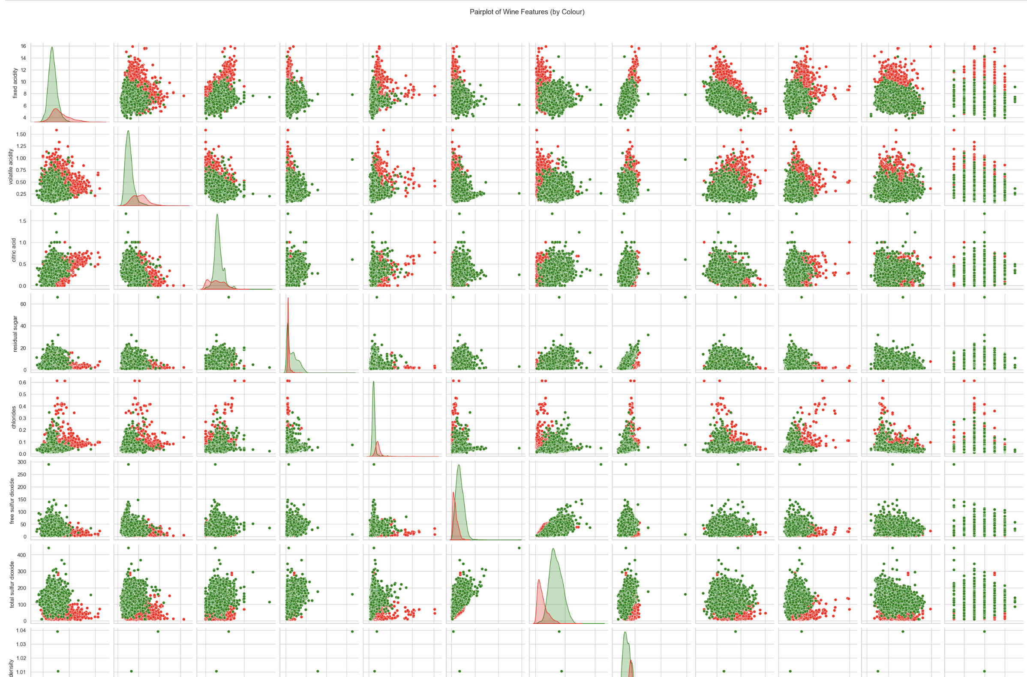

Slide 41
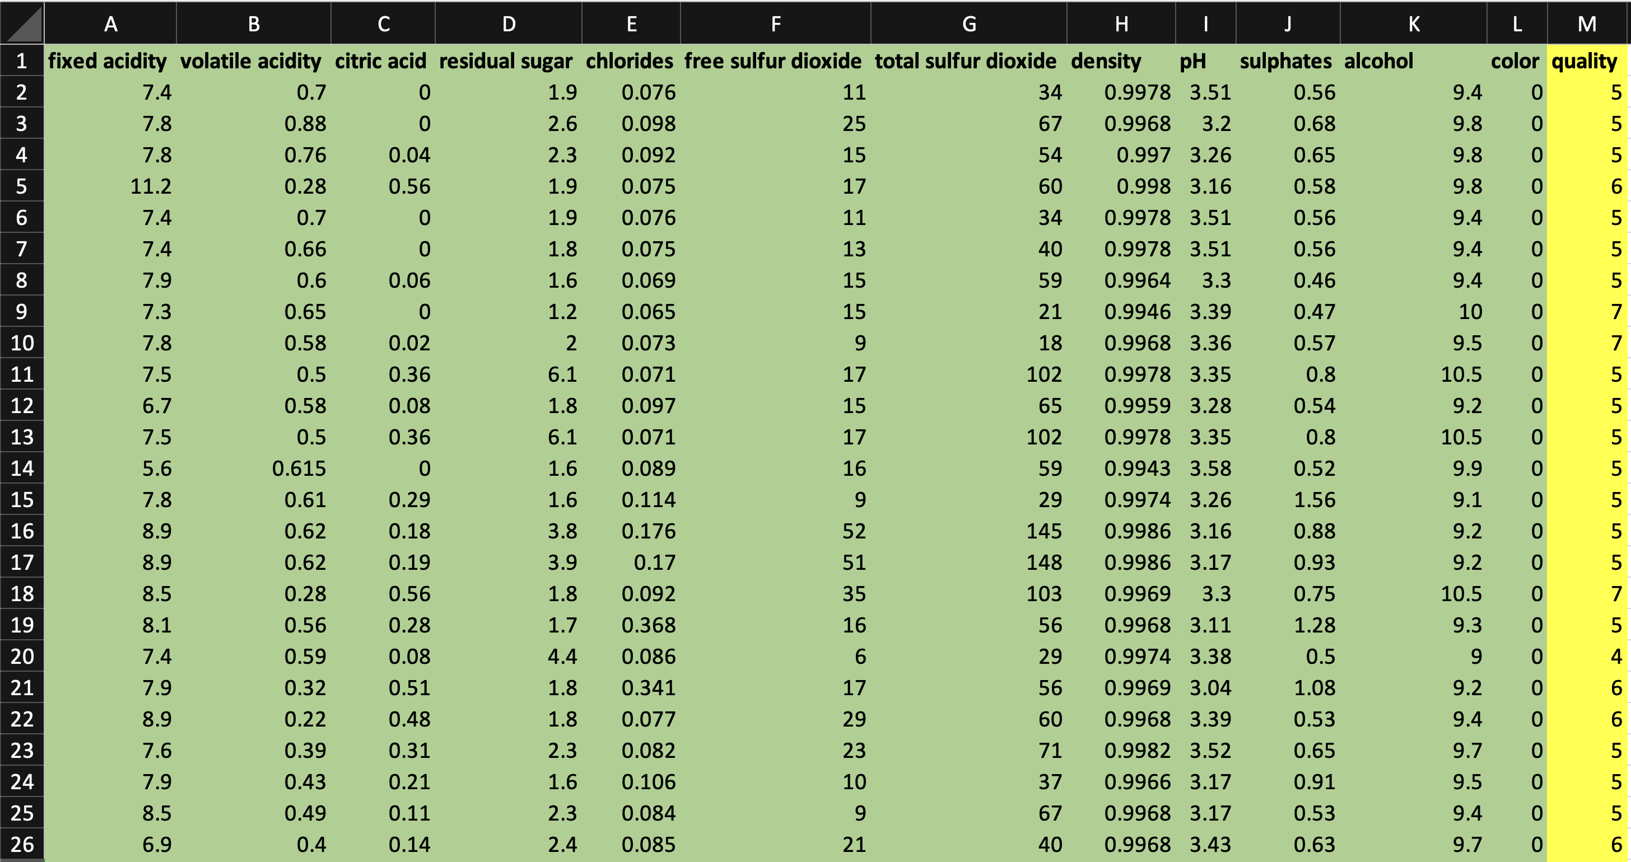
Regression Model
to Predict Wine Quality

Slide 42
Jupyter Notebook
TableData.ipynb
14

Slide 43
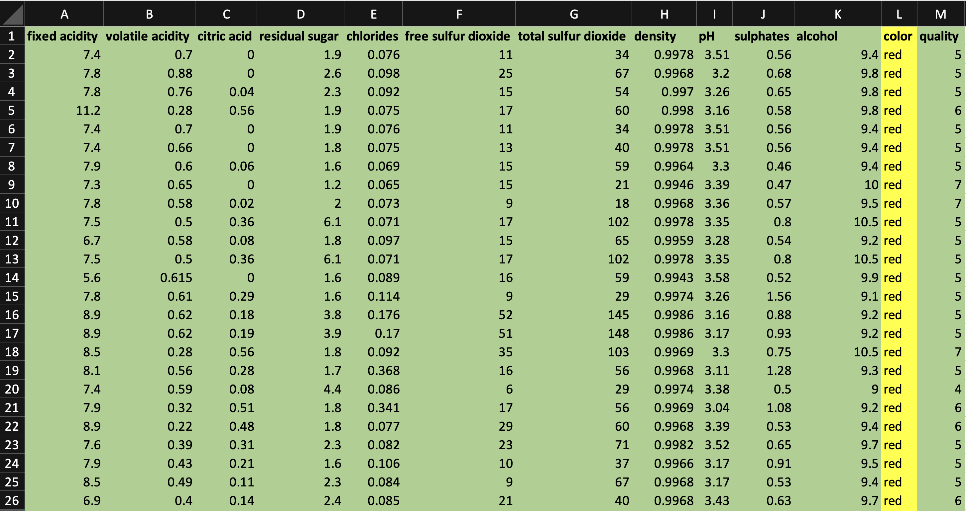
Classification Model
to Predict Wine Colour

Slide 44
Jupyter Notebook
TableData.ipynb

Slide 45
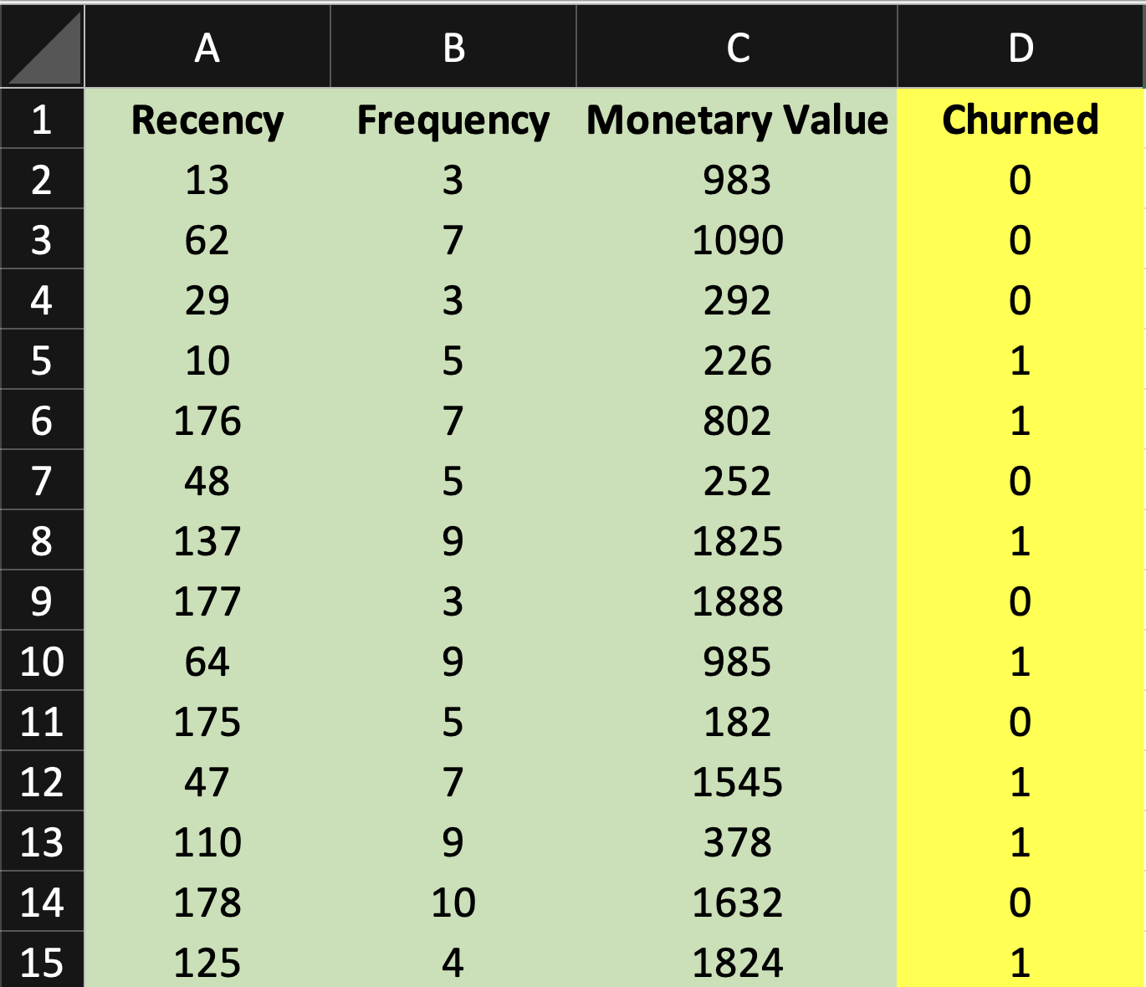

Slide 46

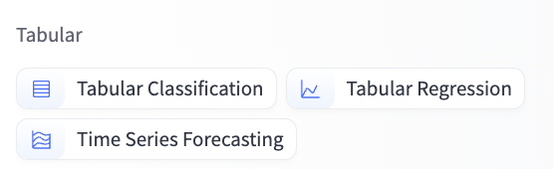

Slide 47
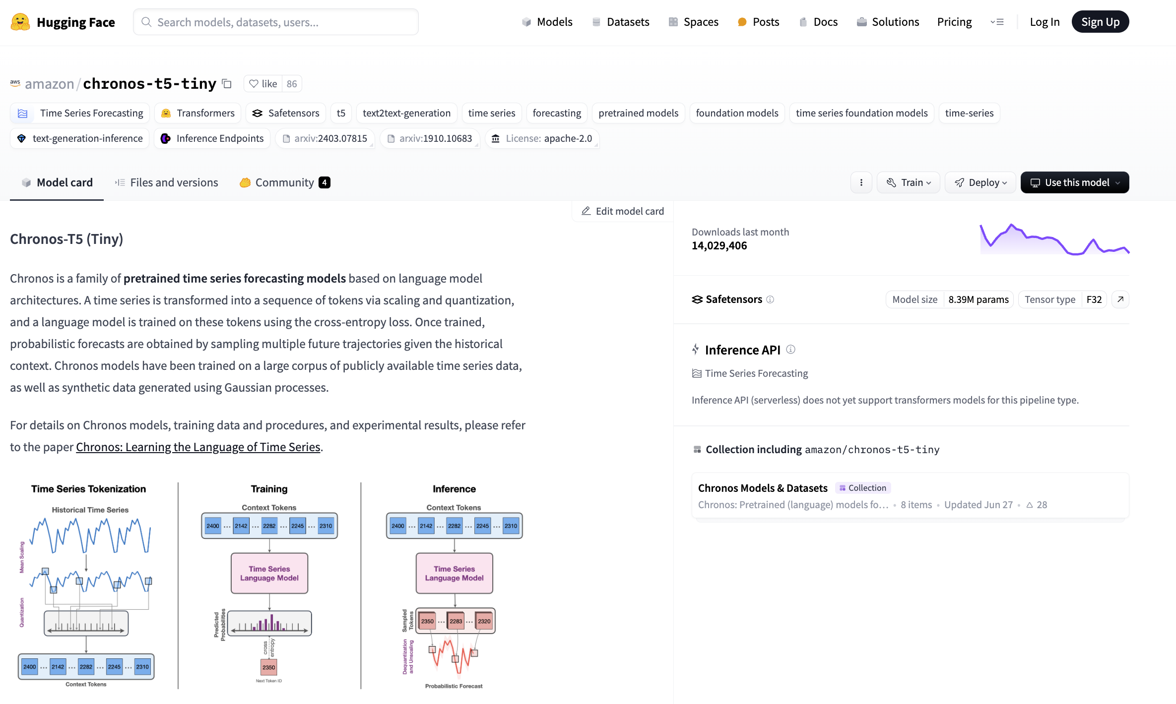

Slide 48
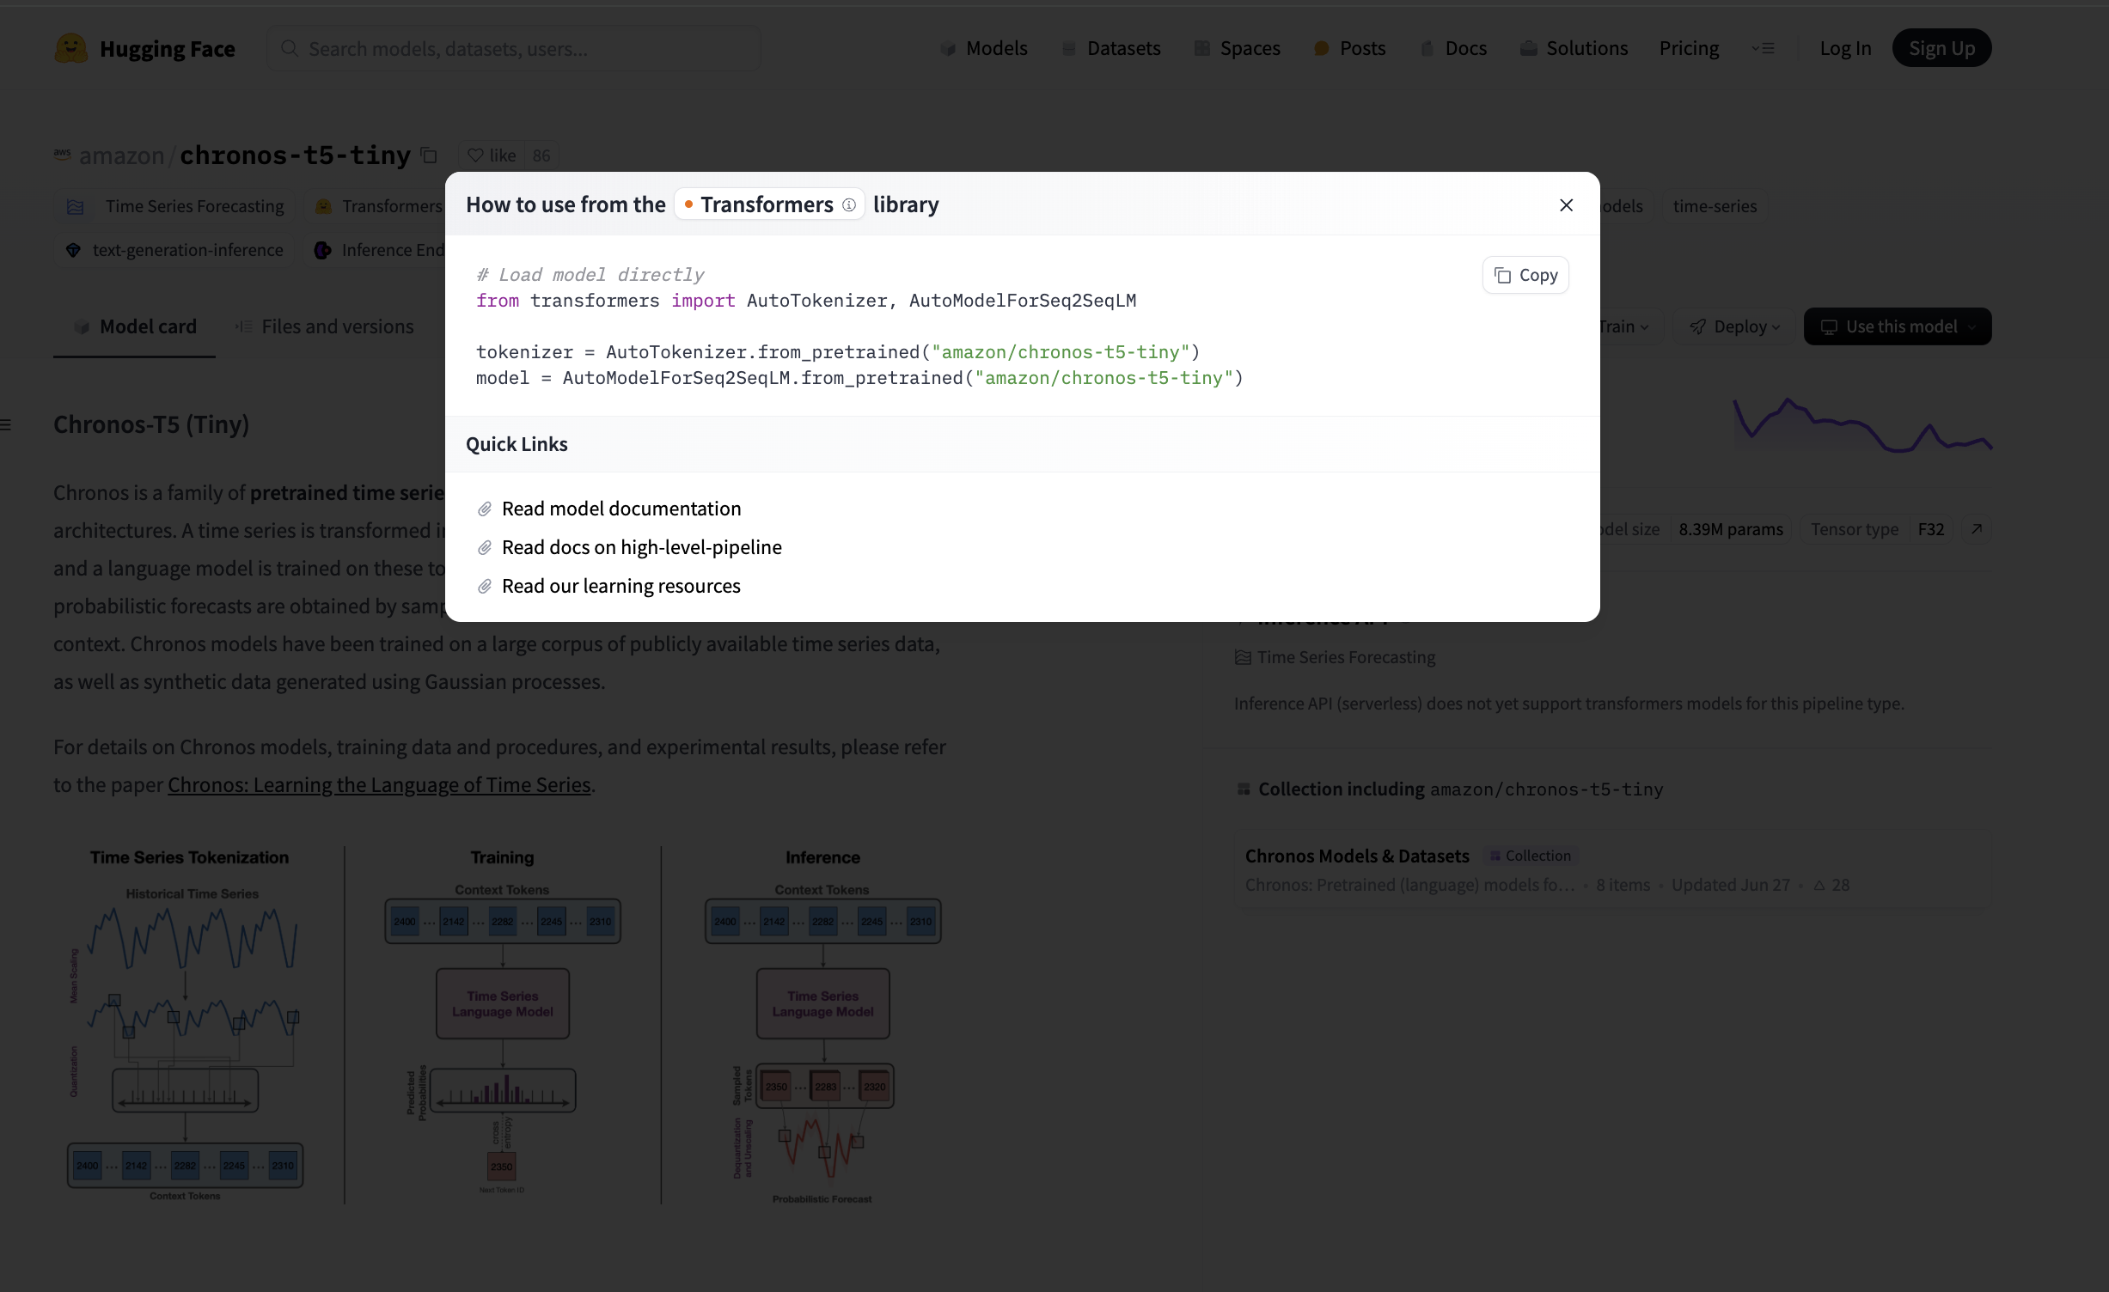

Slide 49
Image / Video Data
15
Notes:
15 min

Slide 50
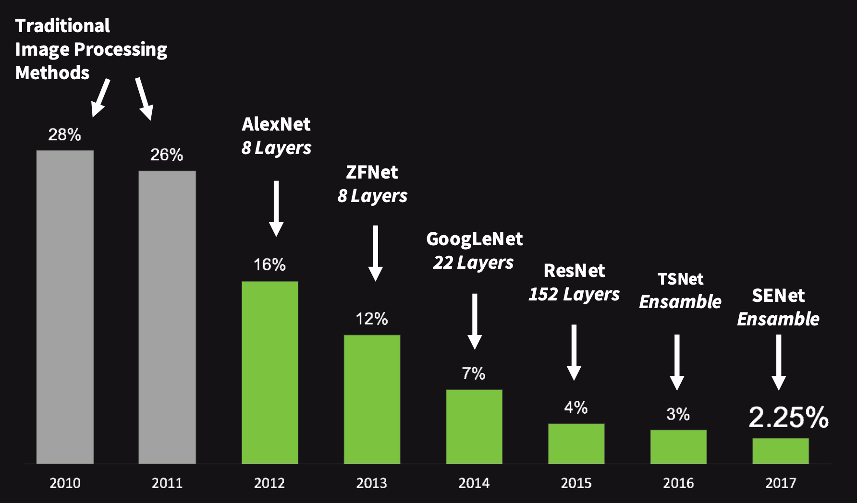
Human error =~ 5%

Slide 51
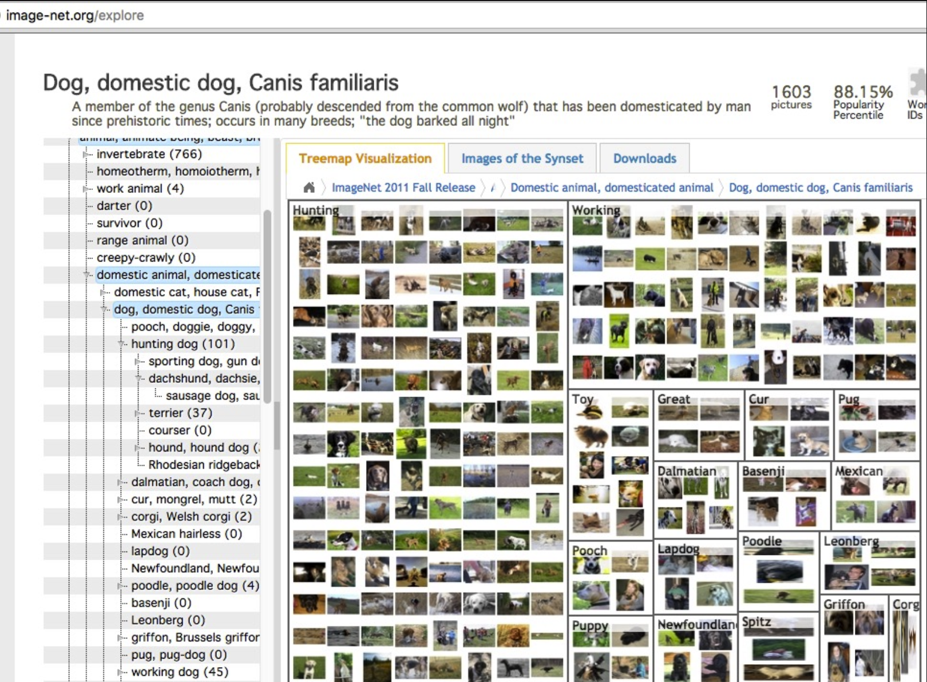

Slide 52
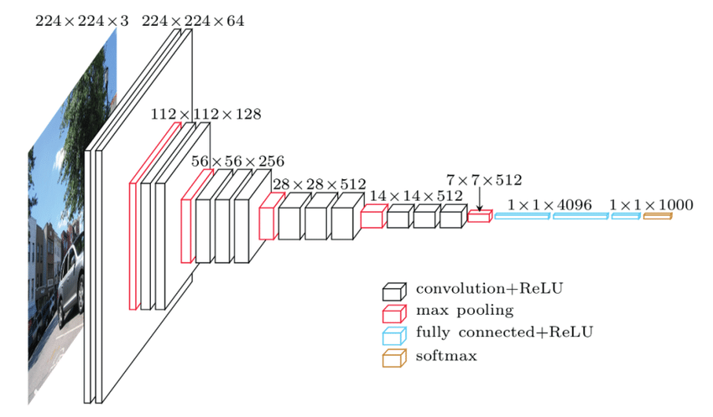

Slide 53
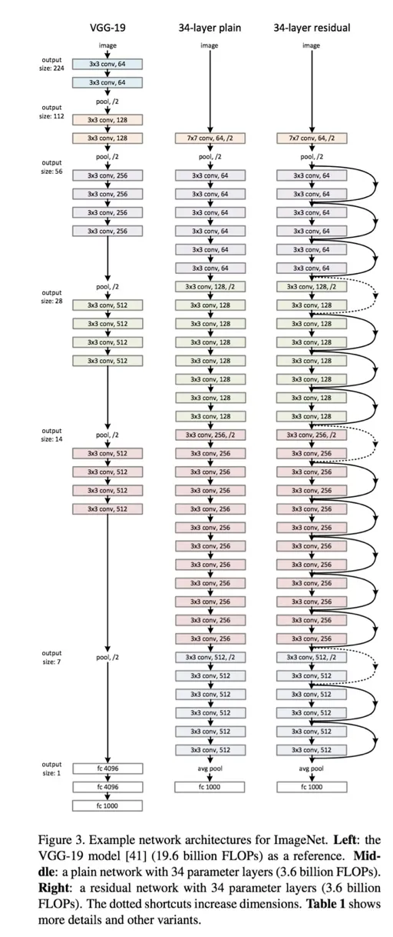

Slide 54
Jupyter Notebook
Let’s use a pre-trained convolutional neural network!
Classification and Visual Search.ipynb

Slide 55
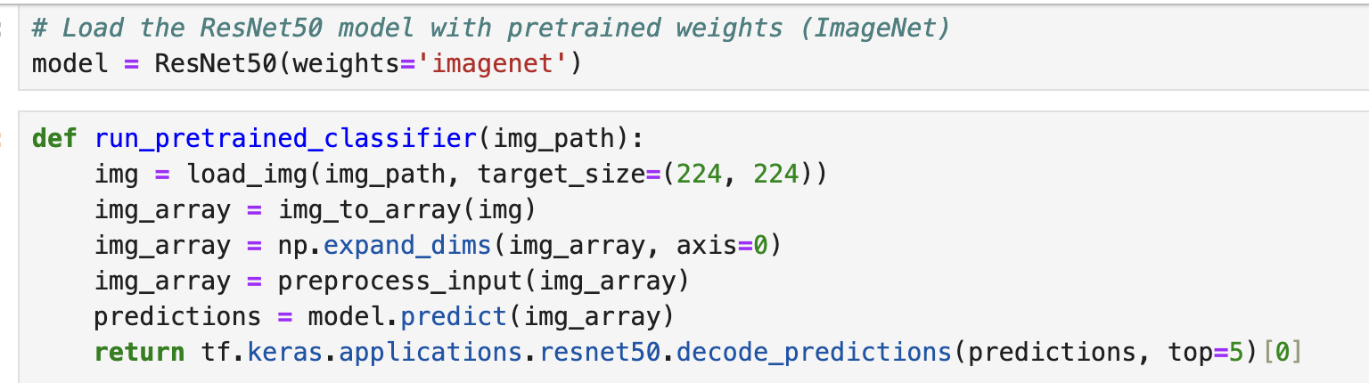

Slide 56
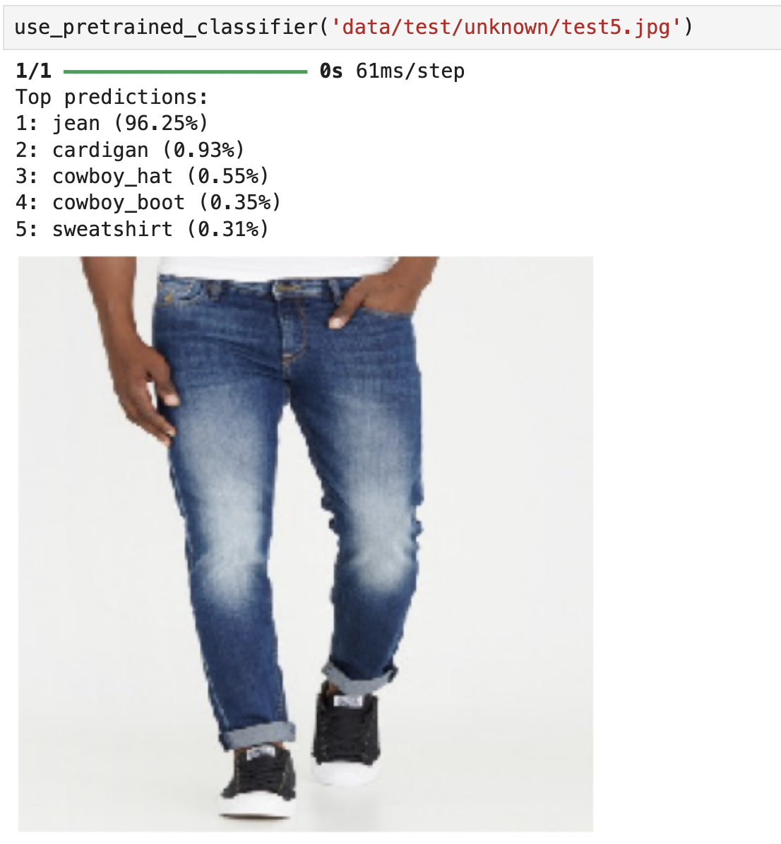

Slide 57
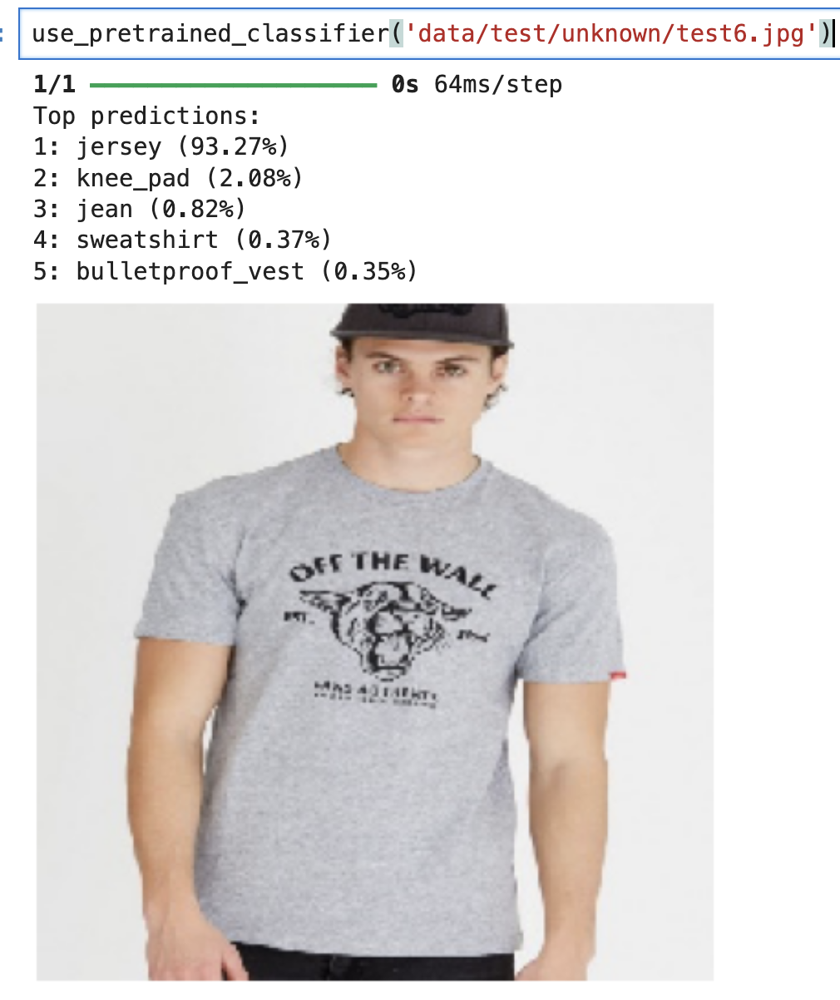

Slide 58
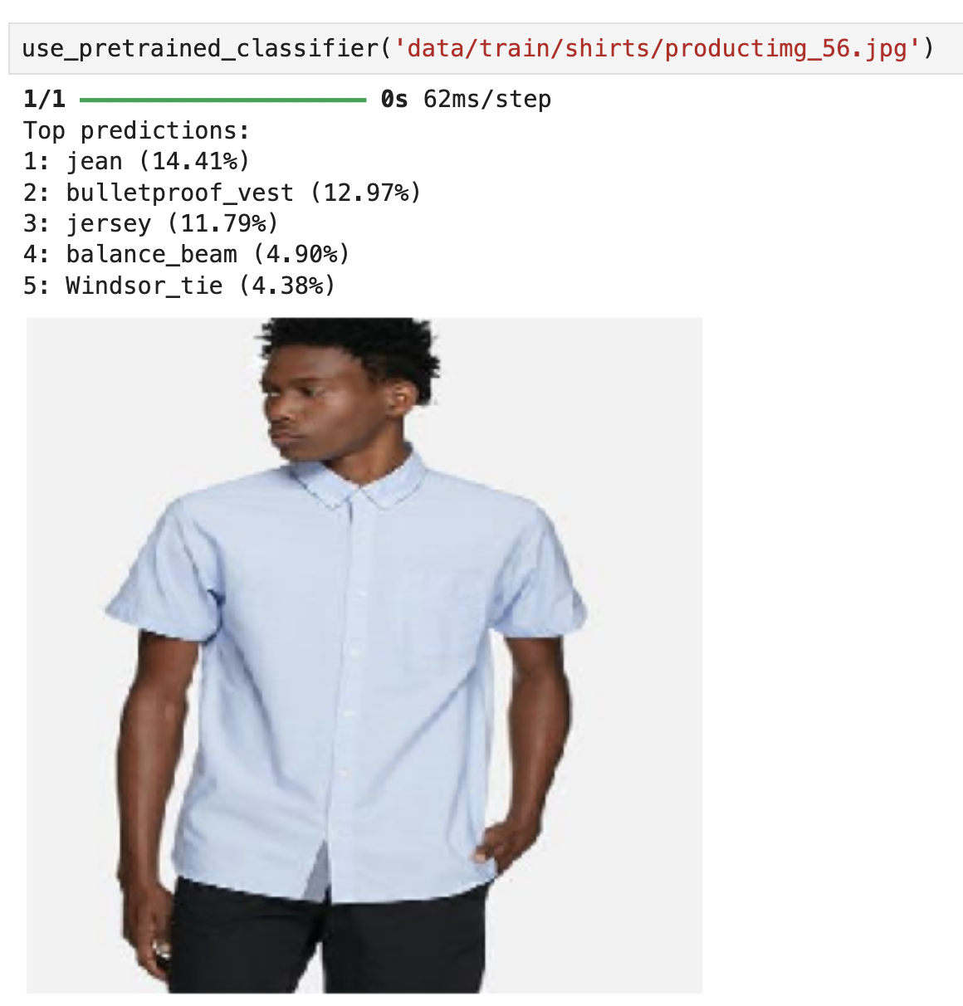

Slide 59
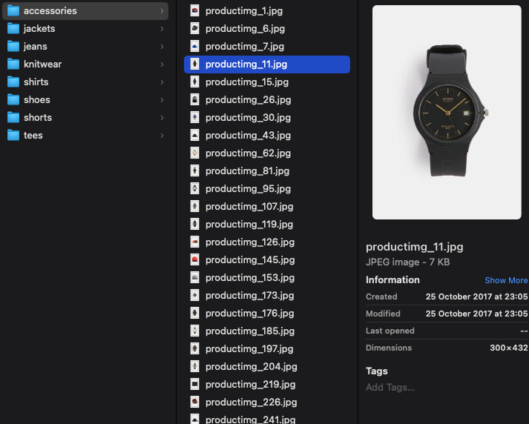
We want to classify into 8 specific categories
Can’t use pretrained model
Must train our own

Slide 60
Jupyter Notebook
Let’s train our own convolutional neural network
to classify product photos into one of 8 categories
Classification and Visual Search.ipynb

Slide 61
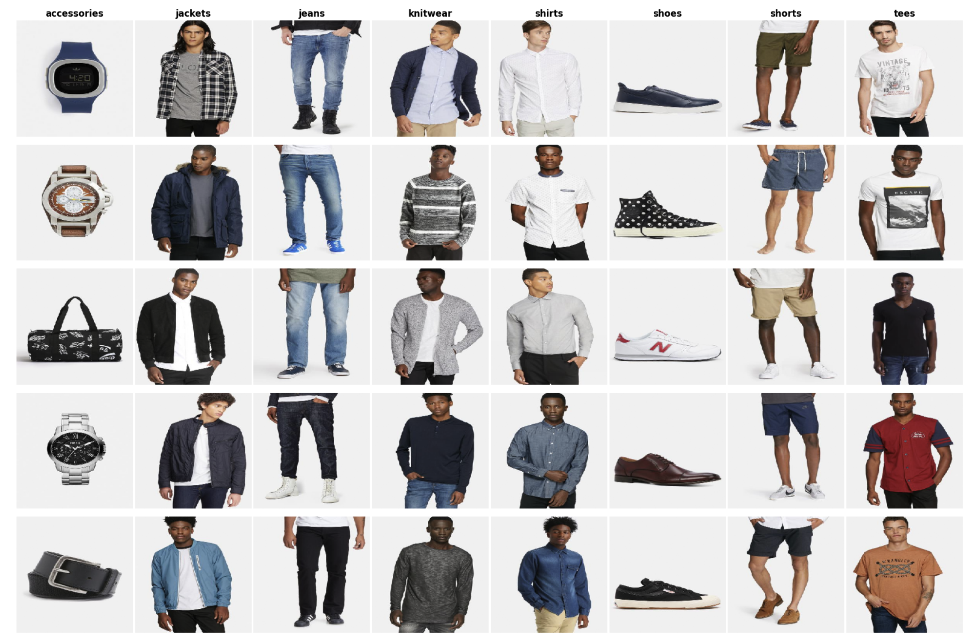

Slide 62
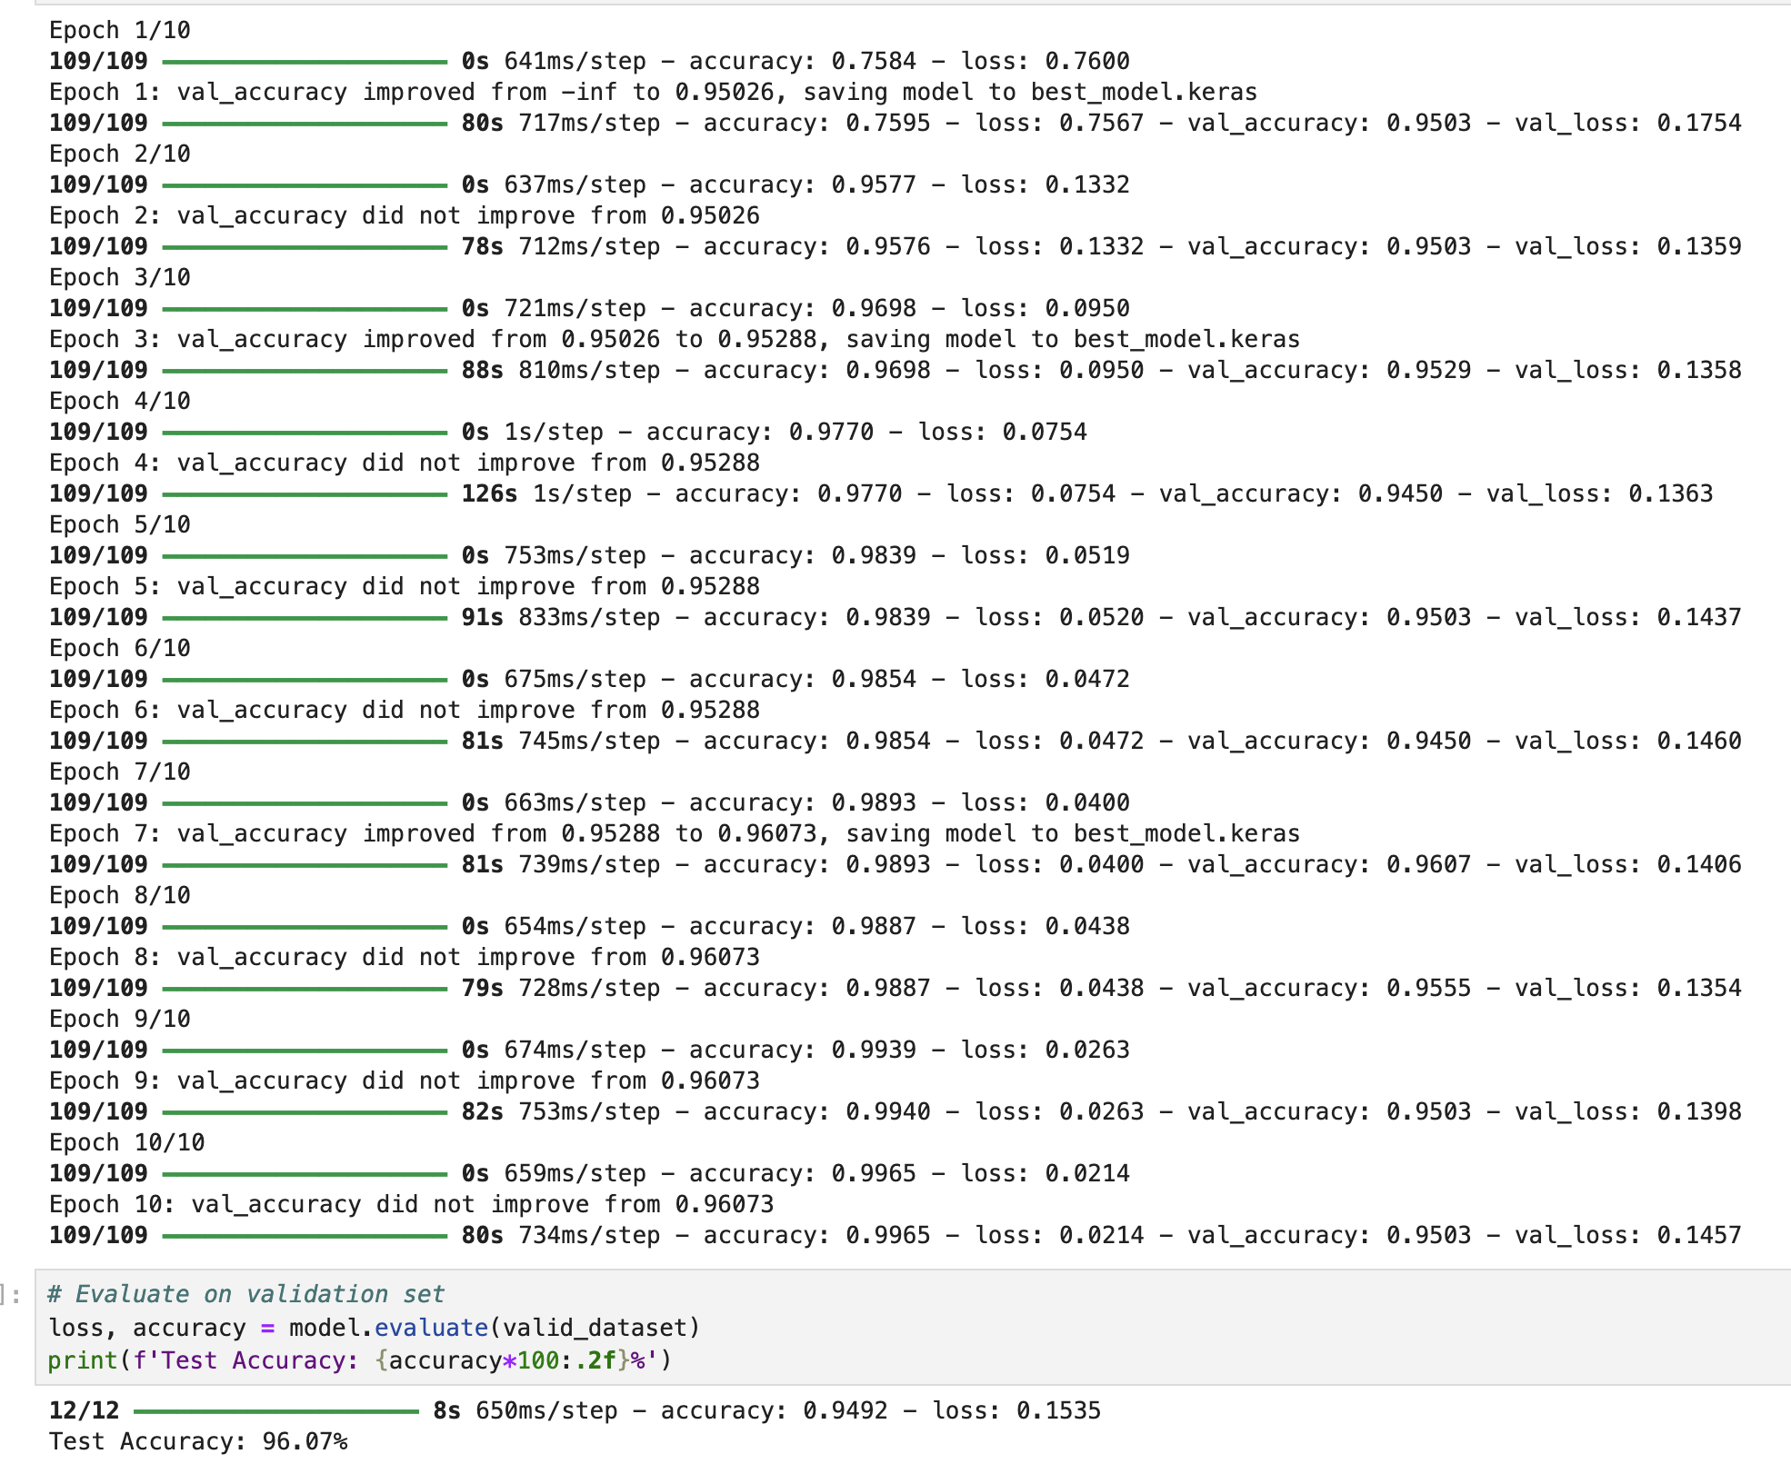

Slide 63

Visual Search
20
Notes:
20 min

Slide 64
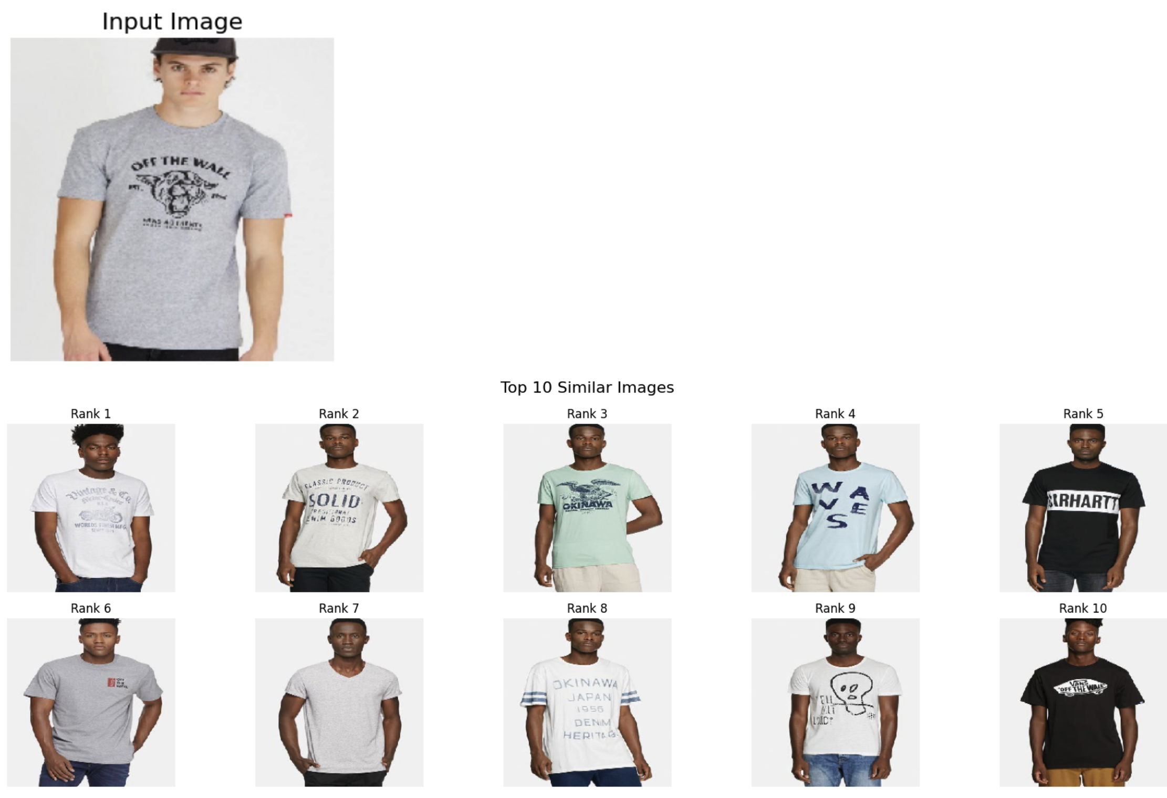
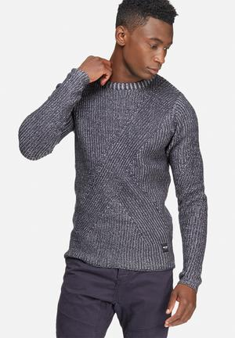
Embeddings
Sleeve
length
how much graphics
f( )
= [0.14, 1.52, …]
f( )
Sleeve length
how much graphics
= [2.98, 0.21, …]
20
Notes:
20 min

Slide 65
4096 dimensional image embedding

Slide 66
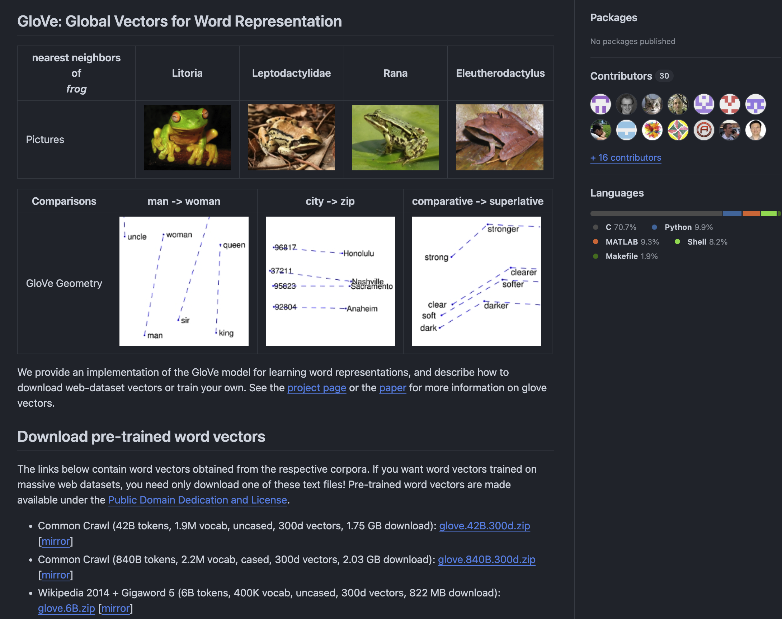

Slide 67
Word2Vec Embeddings
Queen = [0.3, 0.9]
King = [0.5, 0.7]
Woman = [0.4, 0.4]
Man = [0.5, 0.2]

Slide 68
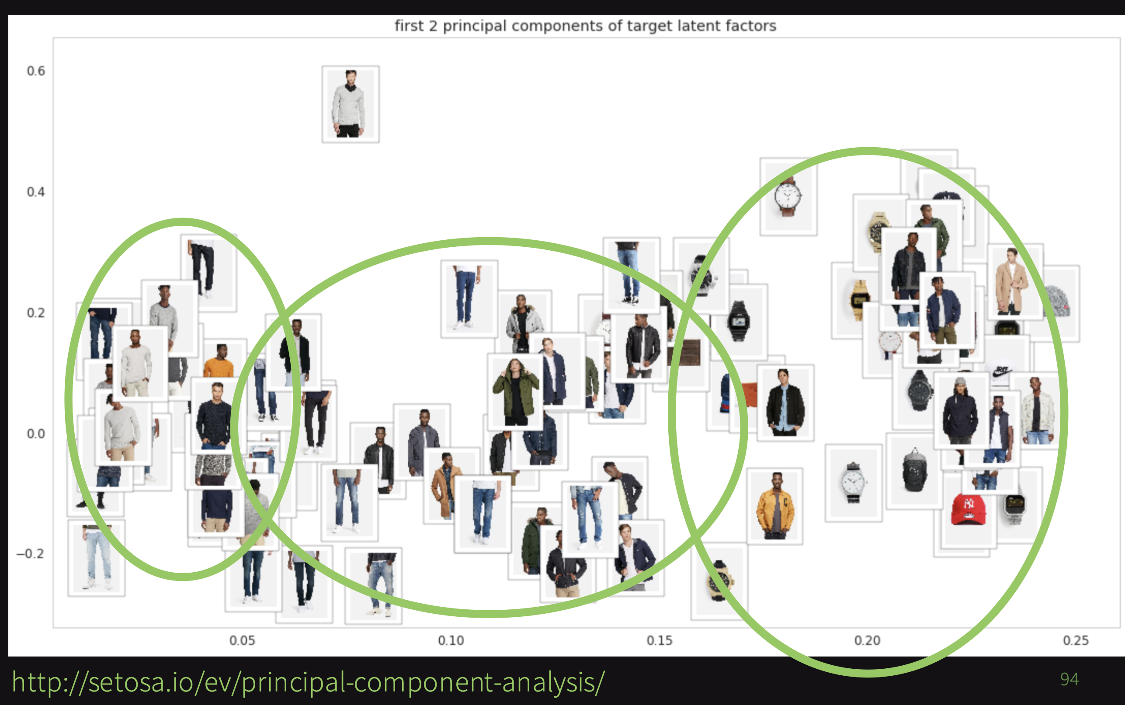

Slide 69
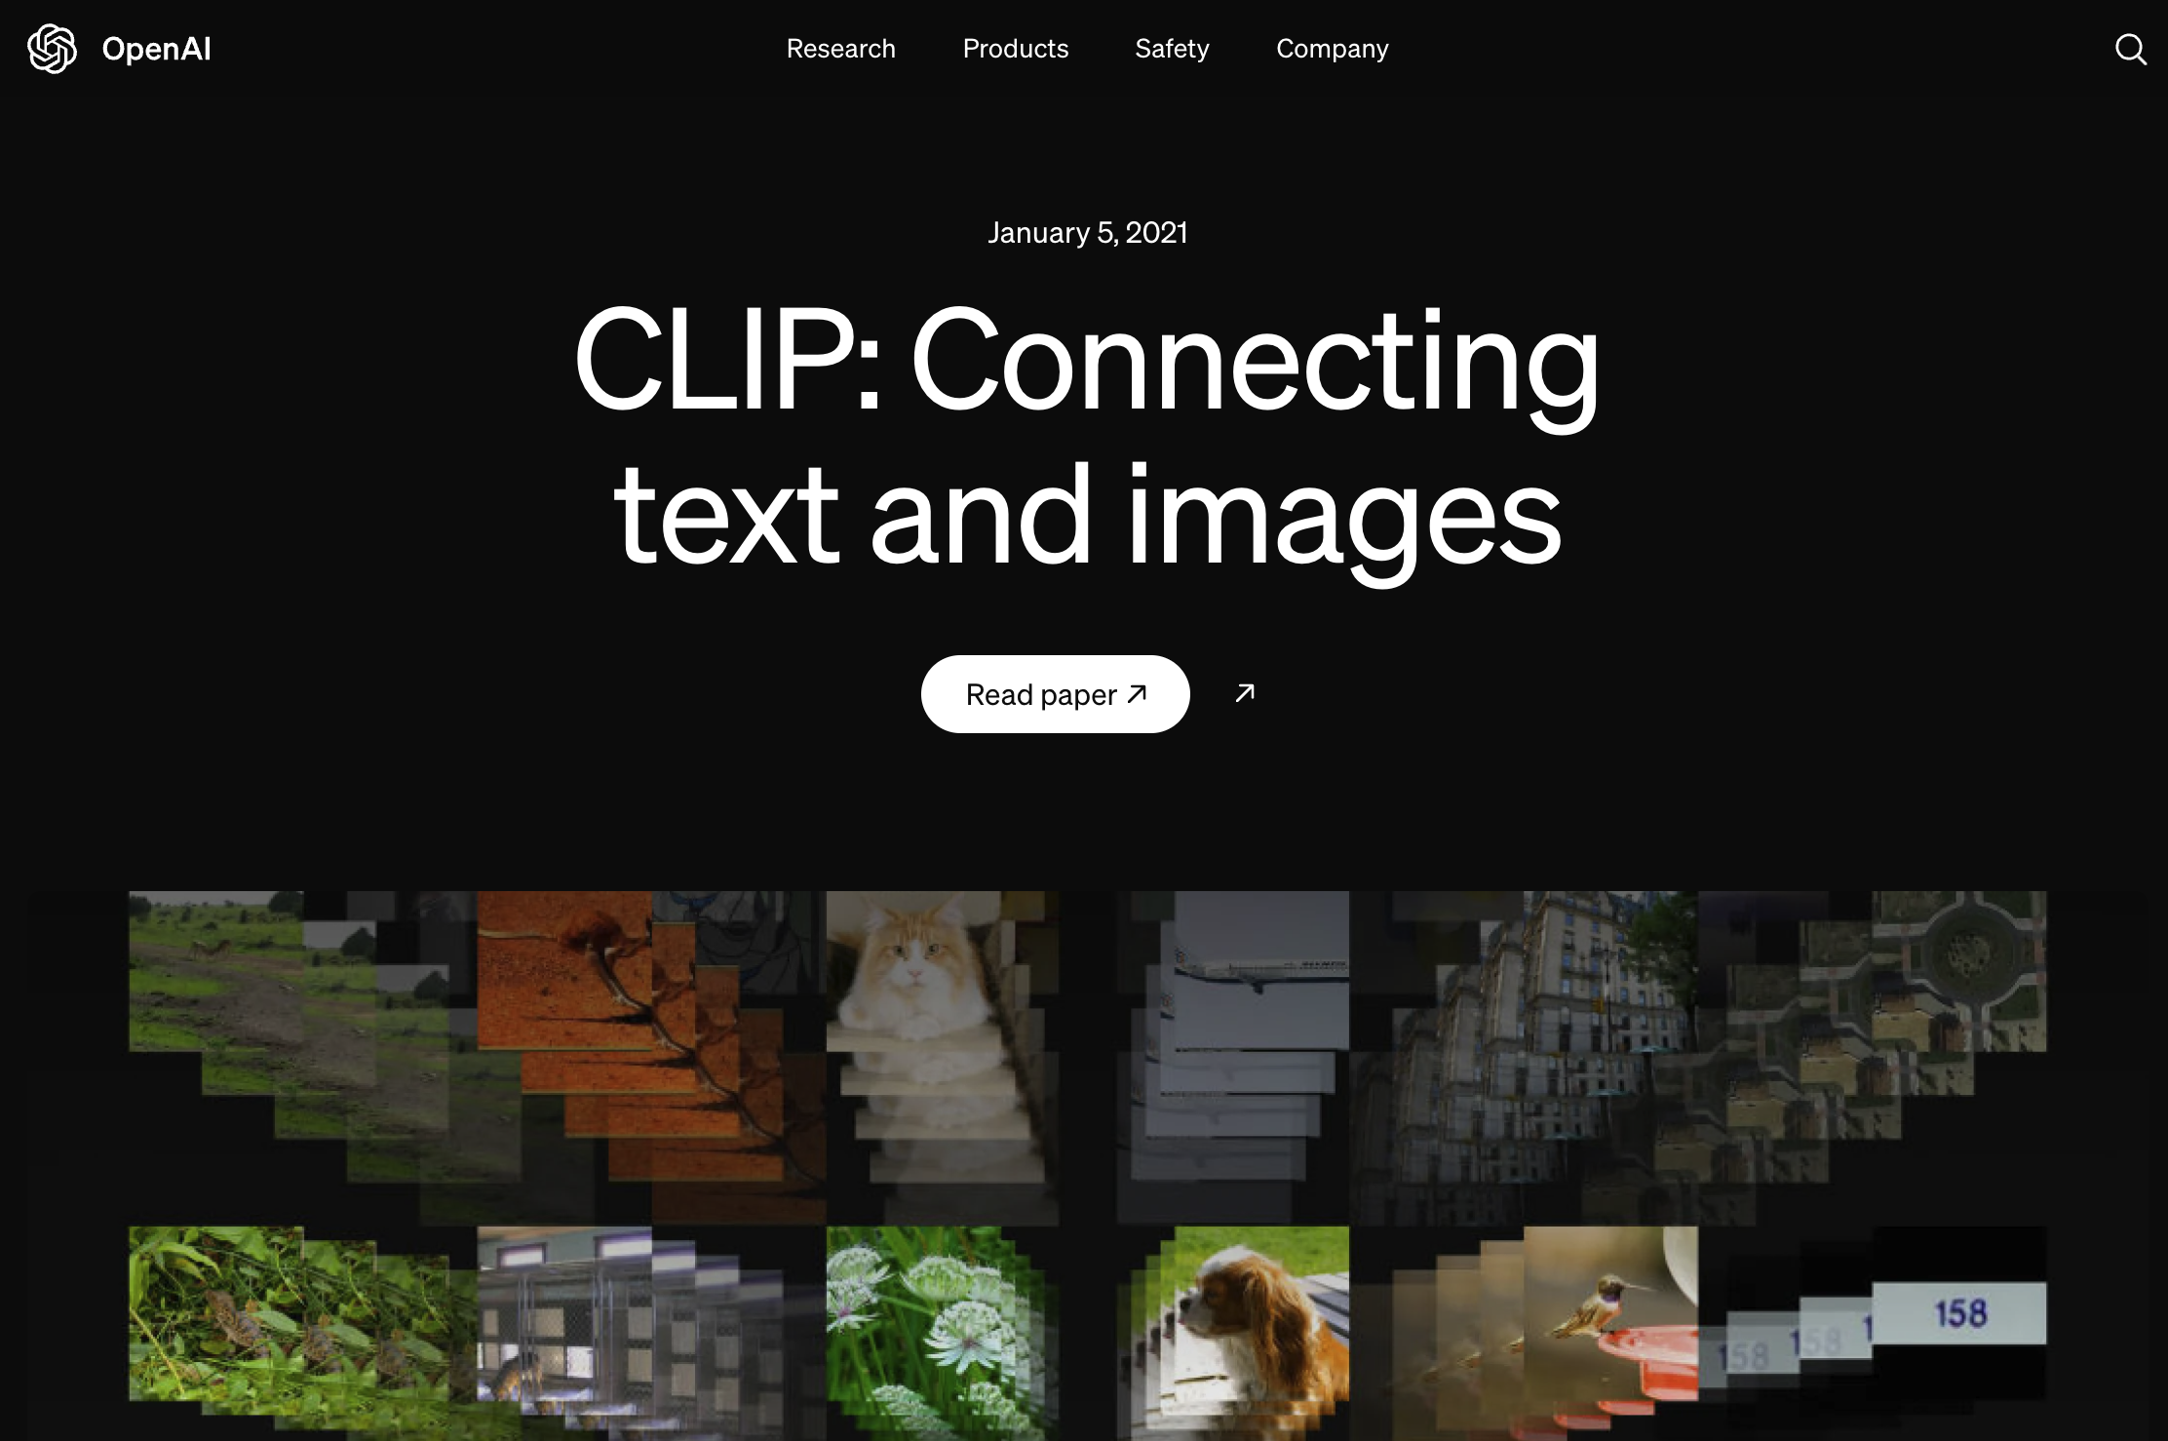

Slide 70
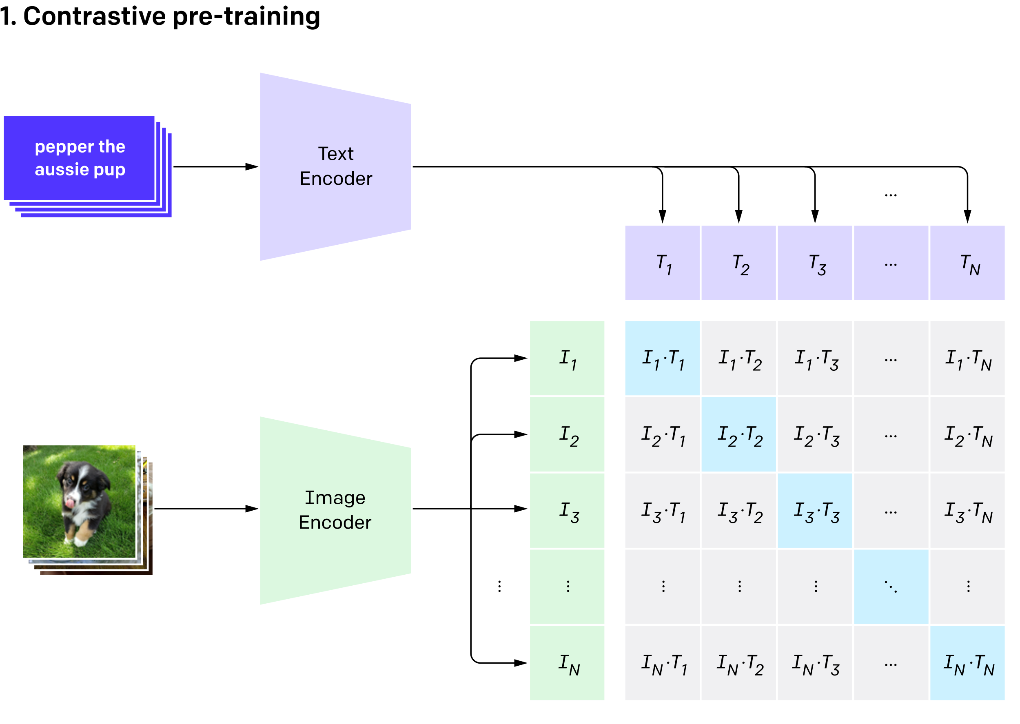
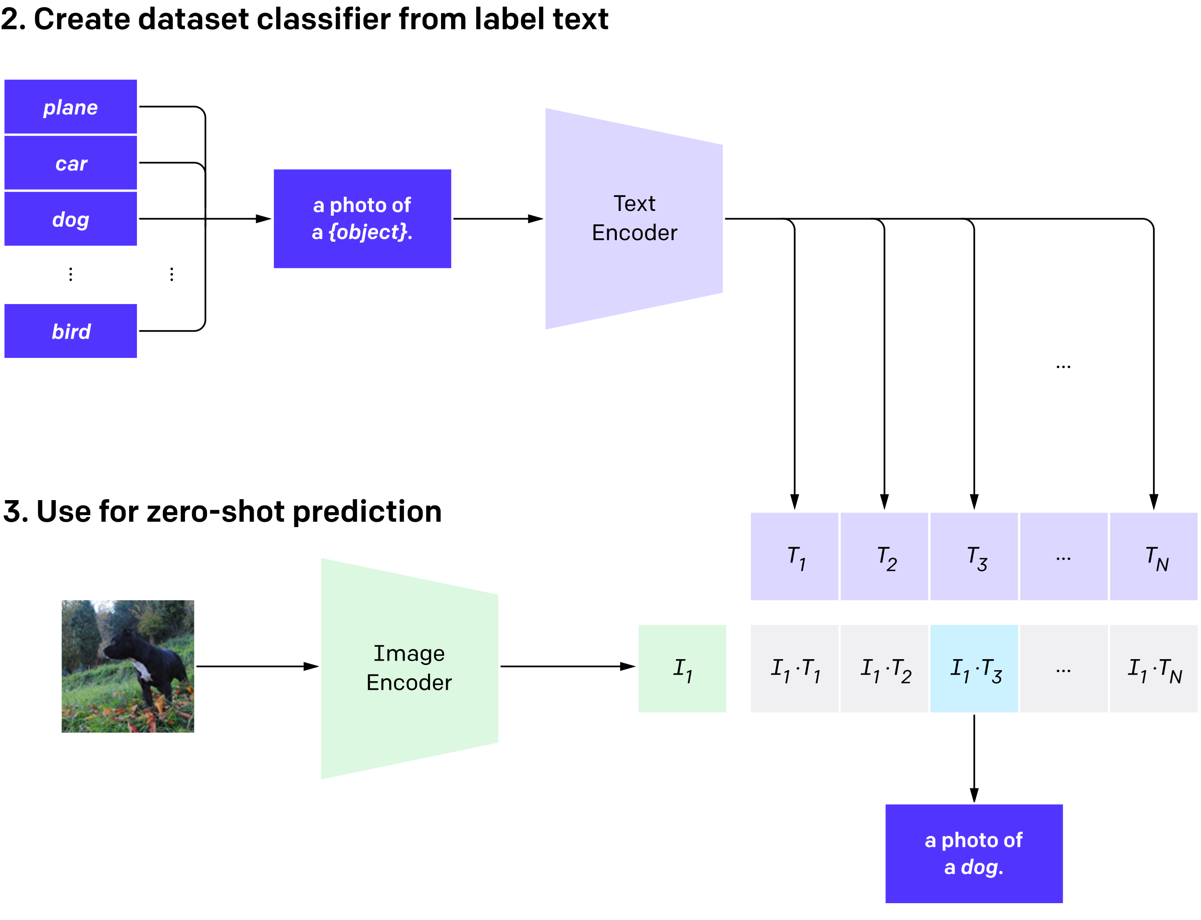
CLIP MultiModal Embeddings

Slide 71
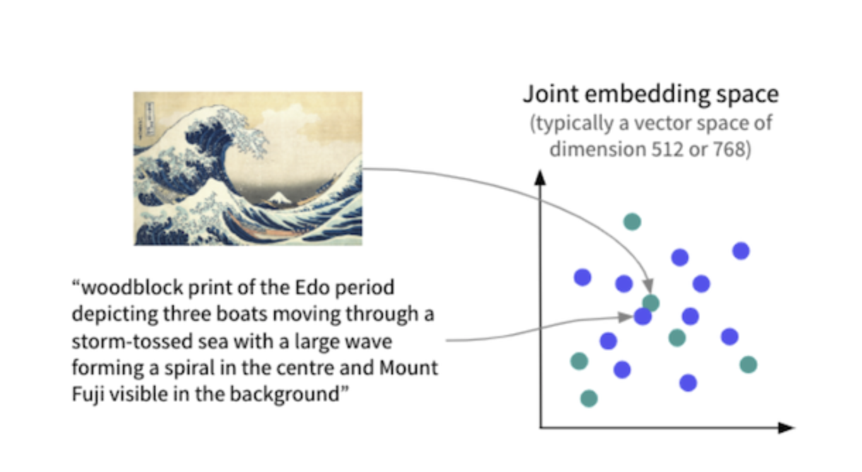

Slide 72
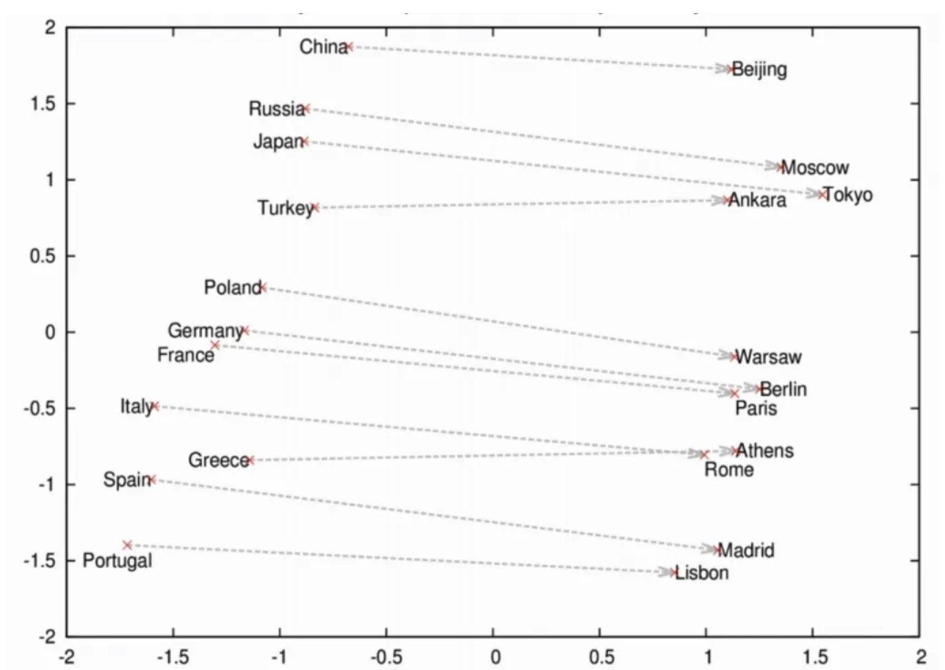
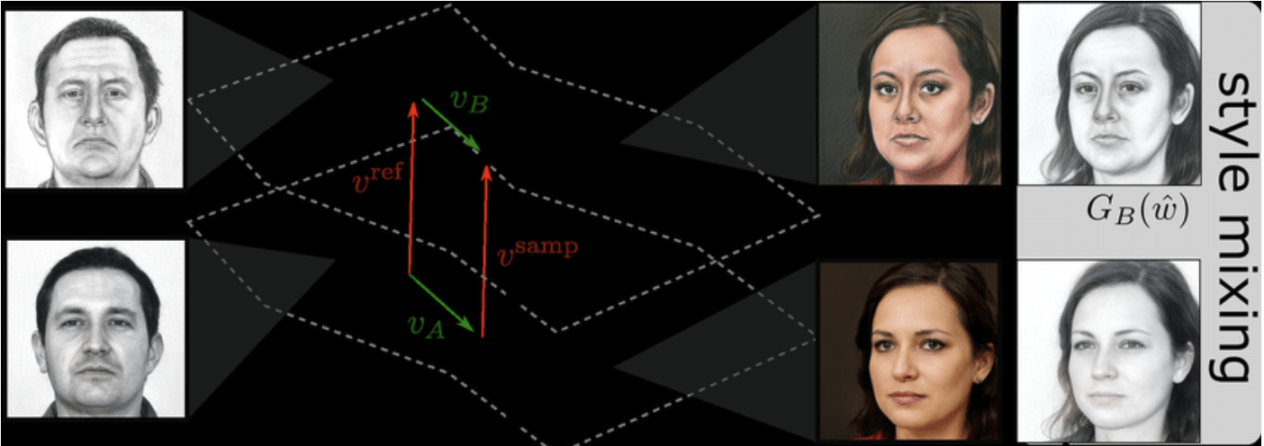

Slide 73
Jupyter Notebook
Let’s do some visual search!
Classification and Visual Search.ipynb

Slide 75
Jupyter Notebook
Let’s detect objects within images
Object Detection.ipynb

Slide 76
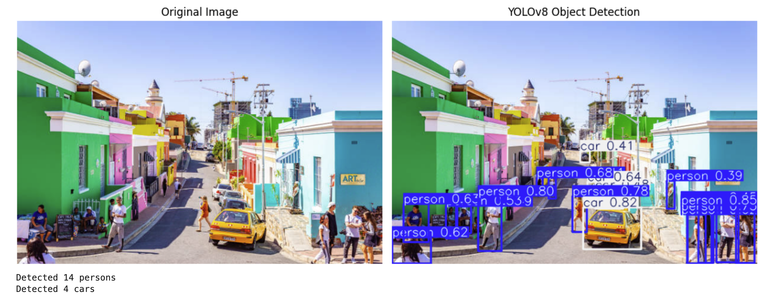

Slide 77
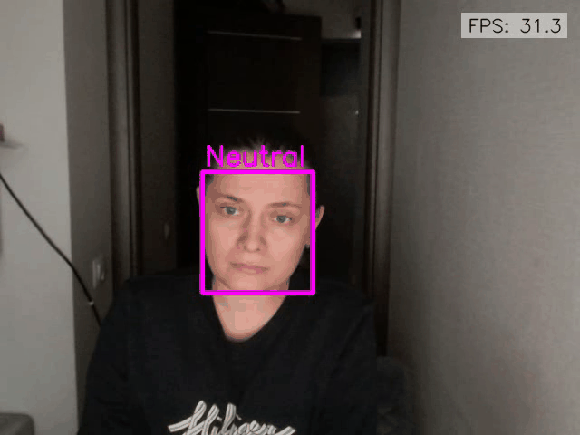
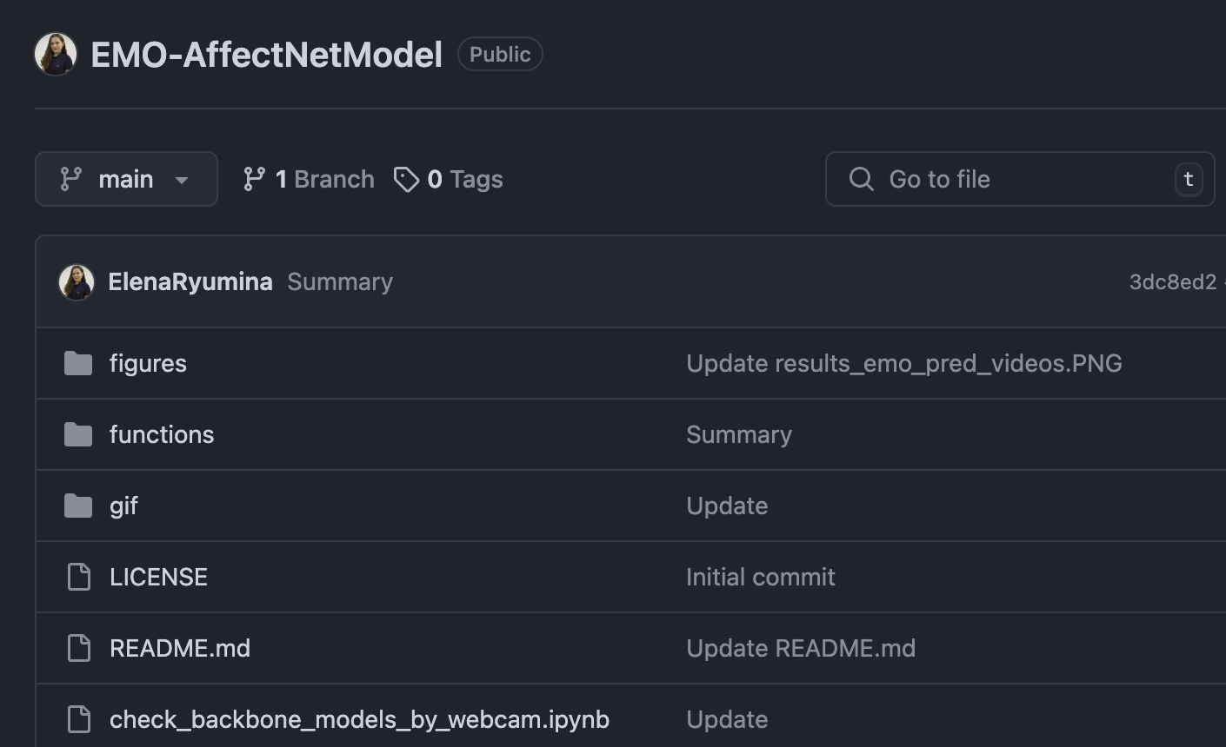
https://github.com/ElenaRyumina/EMO-AffectNetModel

Slide 78
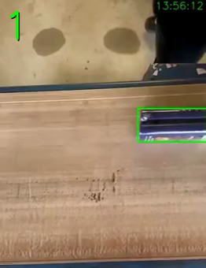

Slide 79

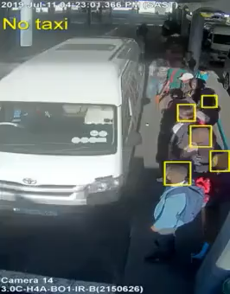

Slide 80
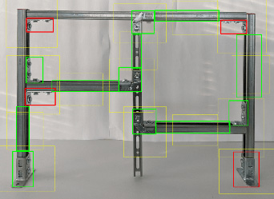

Slide 81
Jupyter Notebook
Let’s segment objects within images
Segmentation.ipynb
25

Slide 82
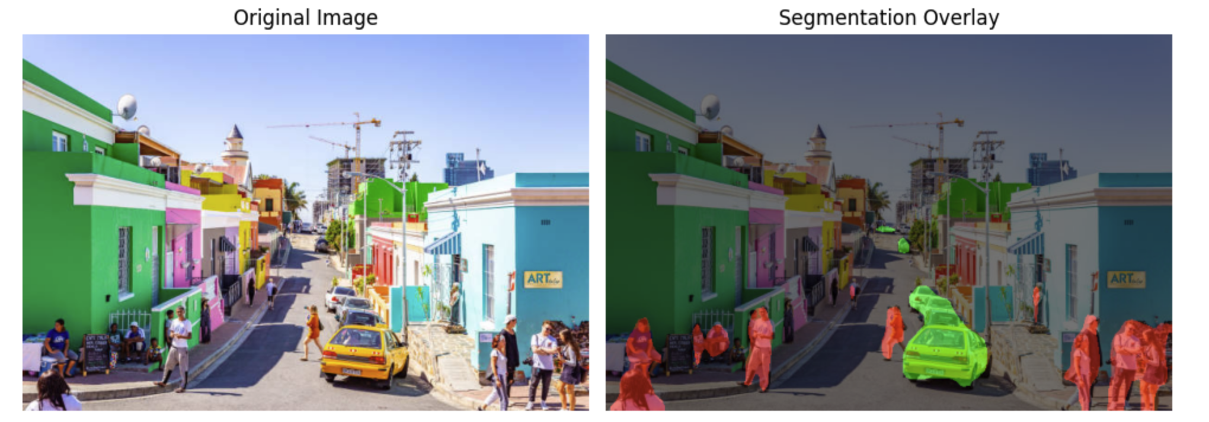
Notes:
25 min

Slide 83
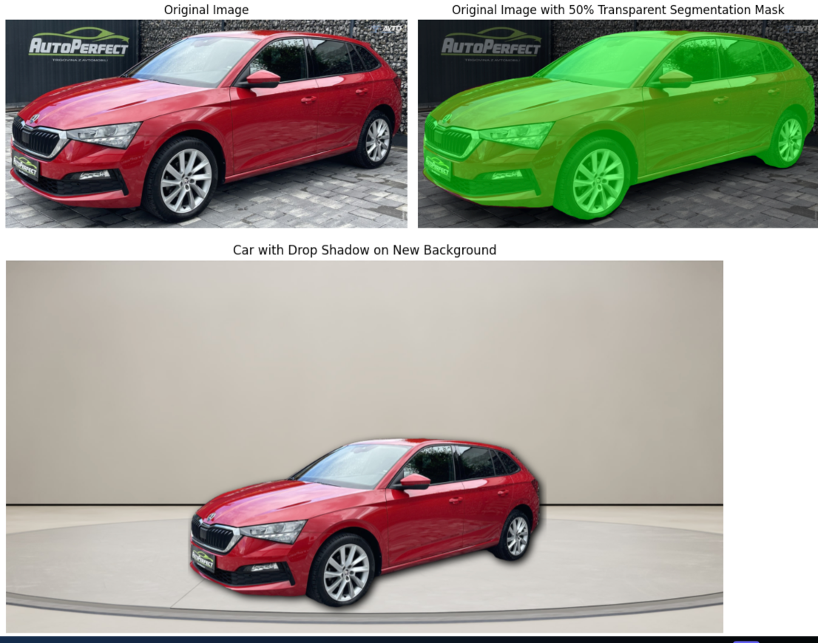

Slide 84
MultiModal LLMs
Are Cool
https://huggingface.co/spaces/Qwen/Qwen2-VL

Slide 85
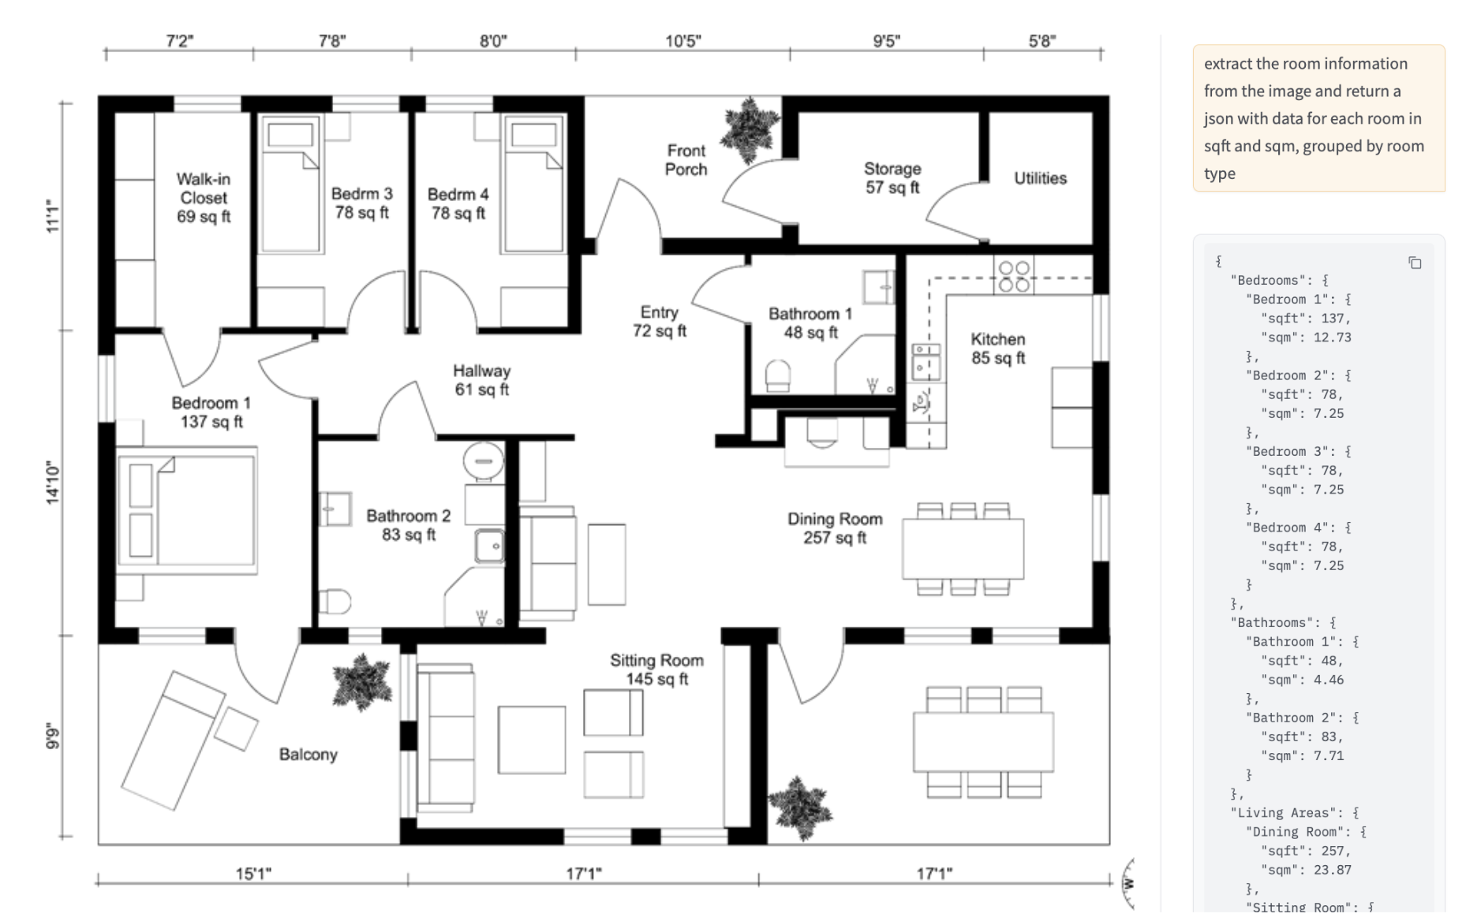

Slide 86



Slide 87



Slide 88



Slide 89


Slide 90
Speech Data
28

Slide 91


Slide 92


Slide 93


Slide 94
Jupyter Notebook
Transcribe.ipynb

Slide 95


Slide 96

Notes:
30 min

Slide 97
Homework
Jupyter Notebook
Speech emotion recognition.ipynb
https://github.com/mbamvianney/SPEECH-EMOTION-RECOGNITION-WITH-MACHINE-LEARNING
30

Slide 98


Slide 99
Text Data
31

Slide 100
Queen = [0.3, 0.9]
King = [0.5, 0.7]
Woman = [0.4, 0.4]
Man = [0.5, 0.2]

Slide 101
Queen = [0.3, 0.9]
King = [0.5, 0.7]
Woman = [0.4, 0.4]
Man = [0.5, 0.2]

Slide 102
Game of Thrones
Lord of the Rings
Pulp Fiction
Mission Impossible

Slide 103
Embeddings
Sleeve
length
how much graphics
f( )
= [0.14, 1.52, …]
f( )
Sleeve length
how much graphics
= [2.98, 0.21, …]
32
Notes:
20 min

Slide 104
Embeddings
Tech topic
Casual tone
f( )
= [2.41, 1.79, …]
Python is the best language for AI
Notes:
20 min

Slide 105

lightning.ai/lightning-ai/studios/rag-using-llama-3-2-by-meta-ai

Slide 106

lightning.ai/lightning-ai/studios/rag-using-llama-3-2-by-meta-ai

Slide 107

lightning.ai/lightning-ai/studios/rag-using-llama-3-2-by-meta-ai

Slide 108

lightning.ai/lightning-ai/studios/rag-using-llama-3-2-by-meta-ai

Slide 109

lightning.ai/lightning-ai/studios/rag-using-llama-3-2-by-meta-ai

Slide 110

lightning.ai/lightning-ai/studios/rag-using-llama-3-2-by-meta-ai

Slide 111

lightning.ai/lightning-ai/studios/rag-using-llama-3-2-by-meta-ai

Slide 112

lightning.ai/lightning-ai/studios/rag-using-llama-3-2-by-meta-ai

Slide 113

lightning.ai/lightning-ai/studios/rag-using-llama-3-2-by-meta-ai

Slide 114

lightning.ai/lightning-ai/studios/rag-using-llama-3-2-by-meta-ai

Slide 115

talks.html
talk.html

Slide 116


Slide 117
Jupyter Notebook
Scrape PyConZA2024.ipynb

Slide 118


Slide 119
Jupyter Notebook
ETL – Load Documents into Database.ipynb

Slide 120



Slide 121


Slide 122
Jupyter Notebook
ETL – Load Documents into Database.ipynb
35

Slide 123

Wrong answer
Calculation questions are hard for LLMs

Slide 124


Slide 125
AI Agents
35
Notes:
35 min

Slide 126


Slide 127
Remember the RAG model failed at this…

Slide 128


Slide 129
DM me @alxcnwy
Excalidraw Generator
Homework

Slide 130


Slide 131


Slide 132


Slide 133
Jupyter Notebook
Let’s make RAG better by giving the AI tools
and giving it self-reflection and reasoning ability
Agent.ipynb
38

Slide 135


Slide 136


Slide 137

40

Slide 138


Slide 139


Slide 140


Slide 141


Slide 142
Notes:
40 min

Slide 143

RAG = Wrong!

Slide 144

Agent = Correct!

Slide 145


Slide 146


Slide 147


Slide 148


Slide 149
Conclusion
43

Slide 150
def ai_model(input):
#
# algorithms f(input) = output
#
return output

Slide 151

def ai_model(input):
#
# include
# buzzwords
return output

Slide 152



def ai_model(input):
#
#
#
return output

Slide 153
Thank You!
Alex Conway
alex@numberboost.com
x.com/alxcnwy

